Slide 1
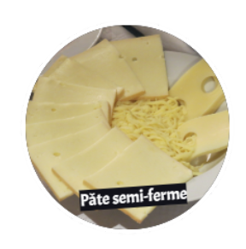
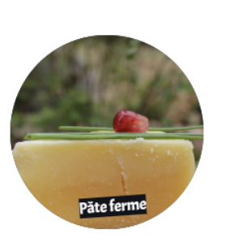
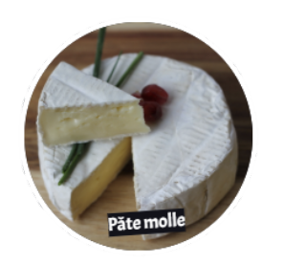
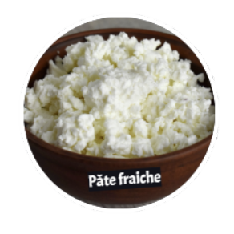
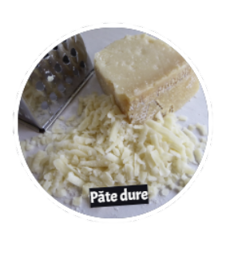
Boursin type cheese
Semi-firm cheese
Soft cheese
Firm cheese
Fresh cheese
Strong cheese
Notes:
What type of cheese does Boursin belong to?

Slide 2
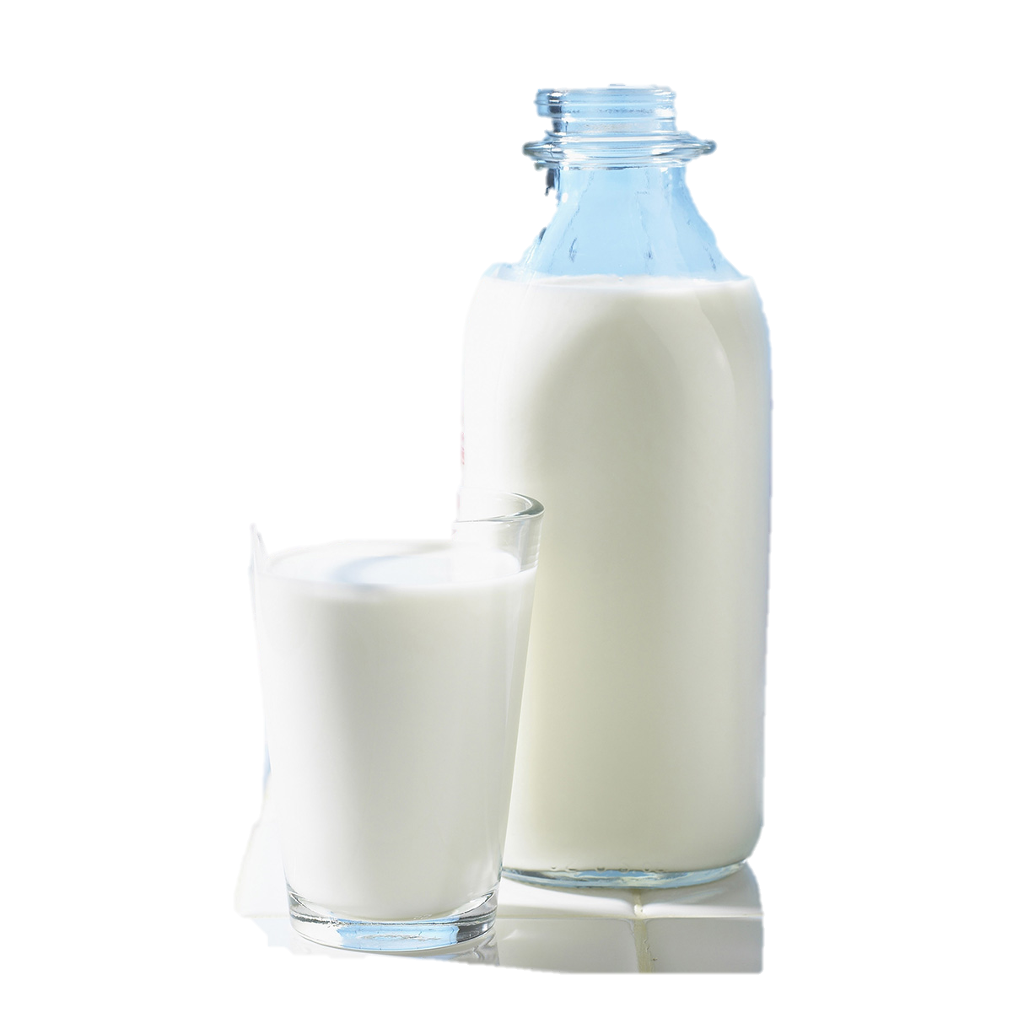
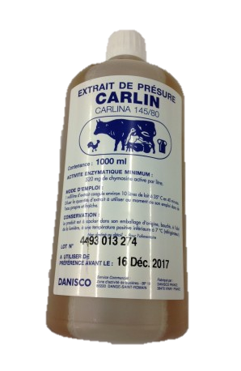
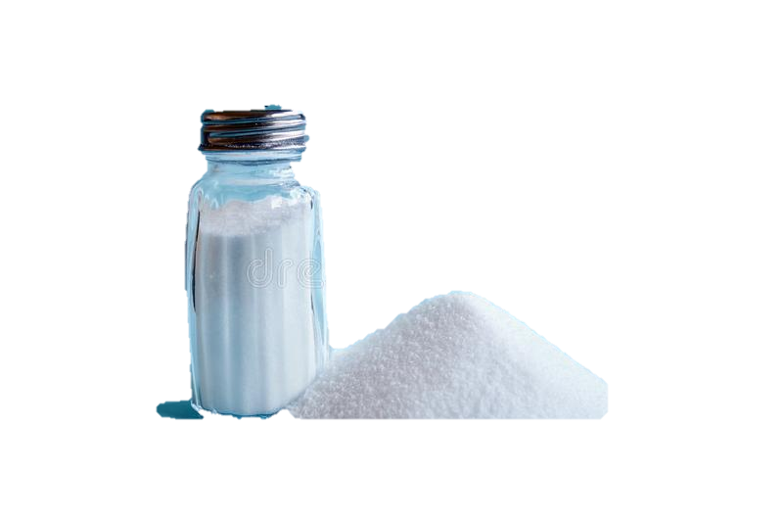
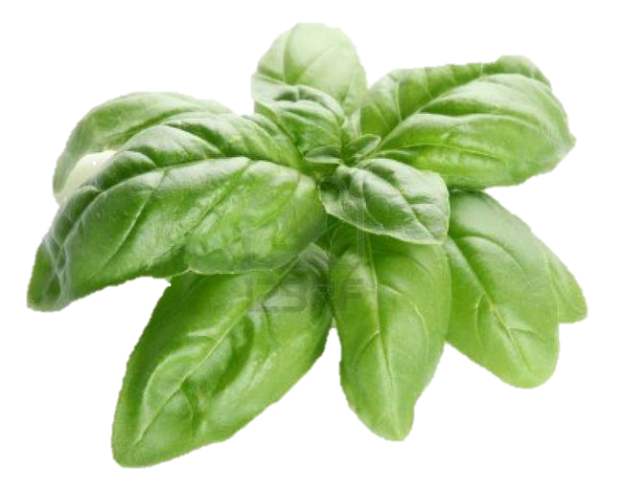
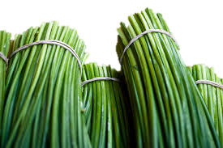
Boursin type cheese is…
+
+
+
Pasteurized milk and cream
Bacterial culture
Salt
Seasoning
What most sets one cheese apart from another is the ripening, that is the maturation process, and the type of cheese.

Slide 3
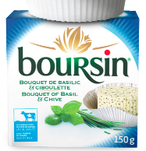
Fresh cheese
Fresh cheese
Fresh cheese
Milk: pasteurized, cow
Colour: white
1
Boursin Basil and chive
Cheese dairy:
Bel Canada
Aroma: basil
Texture: creamy, crumbly
Taste/flavour: lactic, cream, basil
Source: https://www.boursin.ca/en/products/, https://www.fromagesdici.com/fr/fromages/296/boursin
Notes:
Boursin® cheese bears the name of its European founder, François Boursin, and has been produced in Quebec since 2011, by Fromageries Bel Canada inc. in partnership with Agropur.

Slide 4
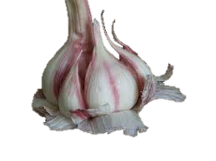
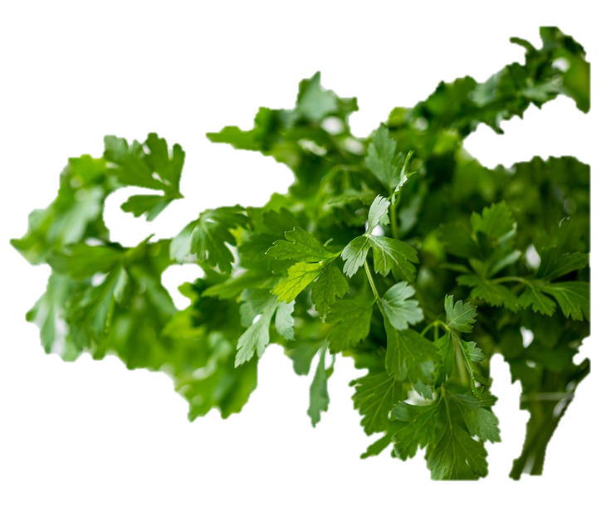
Boursin type cheese is…
+
+
+
Pasteurized milk and cream
Bacterial culture
Salt
Seasoning
What most sets one cheese apart from another is the ripening, that is the maturation process, and the type of cheese.

Slide 5
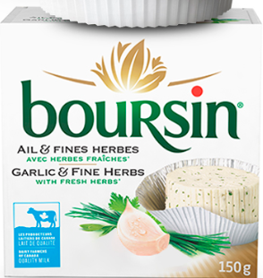
Fresh cheese
Fresh cheese
Fresh cheese
Milk: pasteurized, cow
Colour: white
1
Garlic and fine herbs
Cheese dairy:
Bel Canada
Aroma: garlic
Texture: creamy, crumbly
Taste/flavour: lactic, cream, garlic, parsley
Source: Garlic & Fine Herbs | Inspiration | Boursin, https://www.fromagesdici.com/fr/fromages/296/boursin
Notes:
Boursin® cheese bears the name of its European founder, François Boursin, and has been produced in Quebec since 2011 by Fromageries Bel Canada inc. in partnership with Agropur.

Slide 6
Fresh cheeses
Fresh cheese
Fresh cheeses contain over 80% humidity.
They have not been ripened and have a limited shelf life.
Their texture varies from liquid to unctuous.
They have a light, subtle taste.
They are always pure white.
Ricotta, Boursin, cottage cheese, cream cheese, white cheese, mascarpone, quark, etc.

