Slide 1
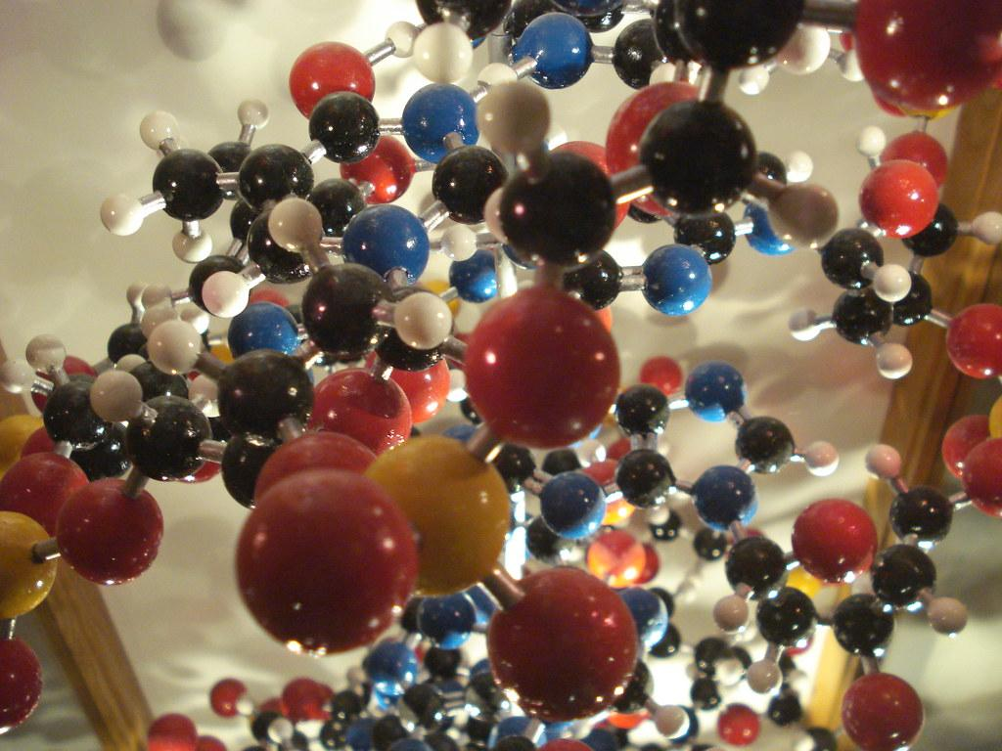
Cheese is…
Notes:
Cheese is the result of a complete or partial coagulation of milk thanks to an appropriate coagulant and draining
https://fabriquetonfromage.com/

Slide 2
Role of the components
Water
Direct impact on firmness
Means of classification
Necessary for enzymatic activity and microorganisms
Influence on ripening speed
Determines the shelf life
Cheese yield
Lipid
Contributes to the development of aromas and flavour
Carrier of fat-soluble aromatic compounds and fat-soluble vitamins (A,D,E,K)
Gives the cheese structure
Cheese yield
Notes:
Present the video on the components of cheese.
WATER
Means of classification: Soft cheese: 50%; Semi-firm cheese: 45% to 50%; Firm cheese 35% to 45%.
The higher the water content, the faster the hydrolysis of casein, fat and lactose by enzymes, which has a direct effect on the flavour of the cheese.
The higher the water content, the higher the yield.
FAT: triglyceride and fatty acids
- During the ripening process, lipolytic enzymes (lipases) hydrolyze the triglycerides and release fatty acids that can be transformed into aromatic compounds and contribute to the development of flavours.
- When the fat melts, it releases aromatic compounds in the mouth, which contribute to the sensory quality.
-The cheese consists of a matrix composed of casein and minerals inside which the fat (visible in the form of holes) is held captive. The % of fat influences the number of holes, they decrease with the decrease of the % of fat, which increases the firmness. Therefore, the less fat there is, the more rigid and firm the structure.
- For an optimum yield, it is necessary to keep as much fat as possible in the curd. However, for a quality cheese, it is necessary to aim for an optimum casein to fat ratio. If this ratio is too high, draining is difficult, which leads to loss of fat in the whey. This affects the texture and flavour.

Slide 3
Role of the components
Proteins
1. Casein
Accounts for 78 to 82% of the protein
Creates the structure of the cheese
Allows the formation of stable micelles
Cheese yield
Contributes to the development of flavour during ripening
2. Lactoserum proteins
Account for 18 to 22% of the protein
Have little impact on the cheese’s structure and flavour
Heat-sensitive proteins
Insensitive to the action of chymosin
Lactose
Carbon source for lactic acid bacteria
Hydrolyzed into glucose and galactose
Hydrolysis:
Decreases pH
Favours coagulation
Forces the demineralization of the micelles
Creates the curd
Inhibits the growth of certain microorganisms
Notes:
PROTEINS - Changes in temperature, pH or salt alter the formation of micelles. The modifications lead to decalcify (demineralize) the casein micelles, which causes coagulation. There are 2 types of coagulation: 1. lactic coagulation caused by the action of lactic bacteria which decrease the pH by transforming lactose into lactic acid. 2. A pressure type of curdling caused by the addition of rennet which hydrolyzes the casein -K which is responsible for the stability of micelles.
So cheese is a reorganization of the caseins in the milk.
The protein content is the most important factor on the cheese yield; 1 g of protein for 0.8 to 0.9 g of water for a pressed cheese and up to 3 g for a fresh cheese - in comparison, 1 gram of fat for 0 to 0.2 g of water.
During ripening, caseins are hydrolyzed into small fragments (polypeptides, peptides and amino acids) by proteolytic enzymes (e.g., chymosin), bacterial enzymes and enzymes naturally present in milk. These enzymes are responsible for the appearance of fruit, floral or bitter flavours. The ammonia smell of some varieties is caused by the action of surface fungus enzymes.
Whey proteins do not coagulate in the presence of chymosin (enzyme). They remain in the whey but can coagulate under the influence of the temperature. The temperature denatures part of the proteins which will allow the retention in the matrix. The whey proteins have the property of retaining water, which can affect the cheese’s texture and flavour. N.B. Ricotta cheese is made from whey proteins.
LACTOSE
The gradual transformation of lactose contributes to the decrease of pH, favours coagulation, forces the demineralization of casein micelles, favours the formation of curds, and inhibits the growth of certain microorganisms.
Note: lactose is mostly eliminated during the draining period. The remaining lactose is transformed into lactic acid. Lactose can cause browning of the cheese when subjected to heat (Maillard reaction).

Slide 4
Role of the components
Minerals
Calcium
Potassium
Magnesium
Sodium
Vitamins
Vitamin A
Vitamin C

