Slide 1
Cheese that stands out

Slide 2
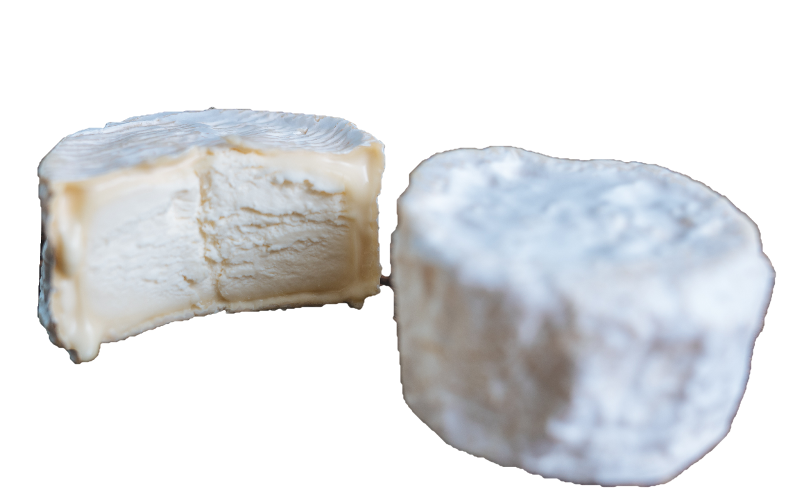
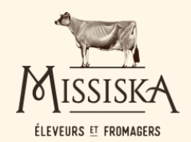
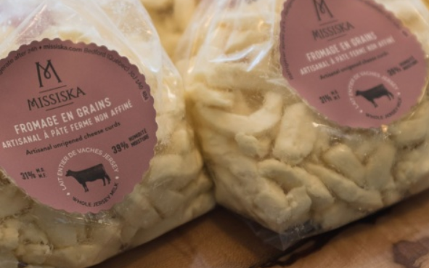
Target clientele
Spreadable cheese for athletes and active people
A different milk
Milk from Jersey cows, labelled as A2 milk, has different characteristics:
“Some people who are lactose-intolerant have tried it and can eat products made from Jersey milk”.
Source: https://missiska.com/fr/nos-produits/jersey-royal

Slide 3
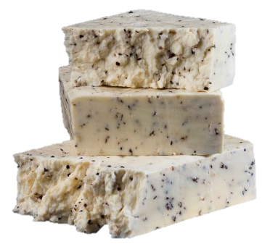
A different milk
A2 milk is the result of traditional animal genetic selection, not genetic modification. Some studies have shown it is more easily digested by people who are lactose-intolerant.
Source: http://fromagesduquebec.qc.ca/fr/fromages/lait-de-vache/ferme-phylum/lignee-la

Slide 4
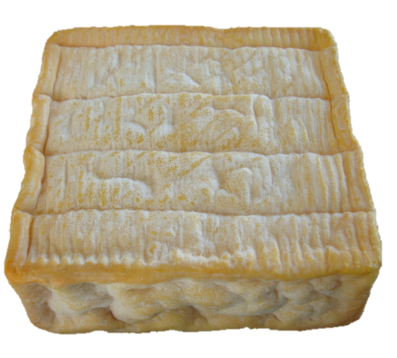
A different shape: square
Most cheeses are round. Changing the shapes makes the product instantly recognizable.
Source: https://www.laboitedufromager.com/fromage/carre-mirabelle/

Slide 5
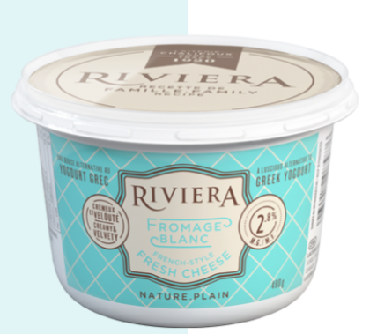
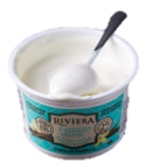
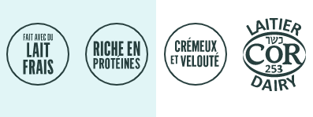
A different product
Cheese that is eaten like yogurt.
Source: https://riviera1920.com/fr/produit/fromage-blanc-nature/

Slide 6
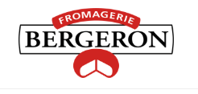
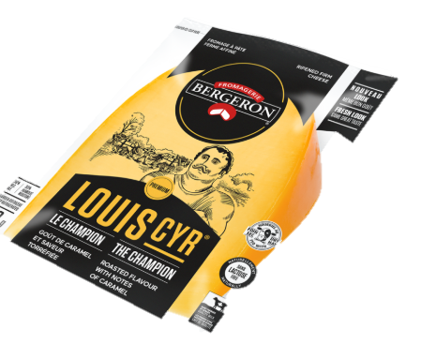
A name with history
Louis Cyr: a strong cheese worthy of a strong name!
Louis Cyr was a famous French-Canadian strongman.
Source: https://fromagesbergeron.com/fromages/produits-fromages-fins-louis-cyr/

Slide 7
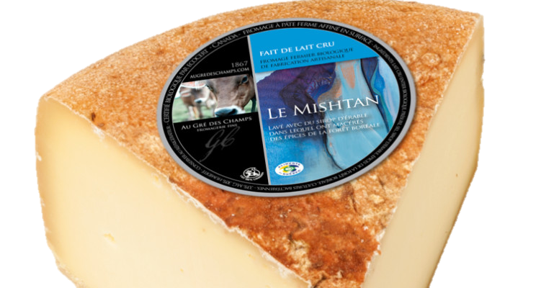
Fromagerie au gré des champs
A name with history
Mishtan, a word which means “maple” in Algonquin, is the latest cheese product from Suzanne Dufresne and Daniel Gosselin.
It’s a semi-firm, semi-cooked cheese whose rind is washed with maple and spices from the Boreal Forest.
Source: https://www.linkedin.com/pulse/l%25C3%25A9rable-et-les-fromages-traversent-le-temps-sans-perdre-proulx/

Slide 8
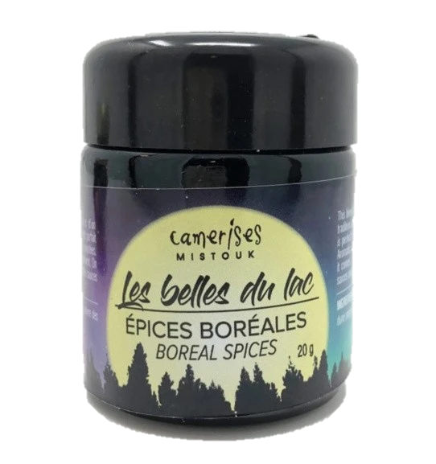
Cheese that highlights local products
Putting the spotlight on local products. “It’s only natural to use maple syrup and spices from the Boreal Forest to develop this recipe honouring Quebec’s maple syrup producers.”
Source: https://terroirsquebec.com/products/epices-boreales-les-belles-du-lac

Slide 9
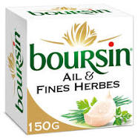
Fromagerie Bel: Boursin and The Laughing Cow
Cheese that gives back to the community
The brand upholds the values of generosity and positivity, along with the fundamental belief in sharing with those who need it most.
Solidarity day: Throughout the year, Bel Canada donates products to its partners, including 6 million portions in 2019.
20 million portions of The Laughing Cow were produced on that day, which allowed the countries involved to form a chain of international solidarity
The company supports its food bank partners more than ever with a $75,000 donation.
Source: https://www.lapresse.ca/affaires/tetes-d-affiche/2020-04-27/du-fromage-pour-la-covid-19

Slide 10
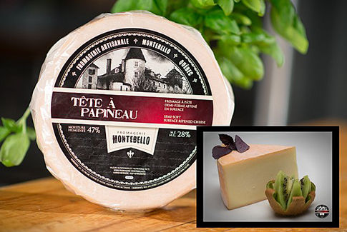
A memorable name
Tête à Papineau is a reference to a popular expression in Quebec: “Ça ne prend pas la tête à Papineau!” (You don’t need Papineau’s brains!), which is itself a reference to a brilliant, gifted speaker, Louis-Joseph Papineau.
The cheese label features the manor Louis-Joseph Papineau had built in Montebello in 1850.
Source: https://fromagerie-montebello.ca/tap.html

Slide 11
Different kinds of production
Production focused on the animal’s well-being.
Production which gives back to the community by supporting local groups.
Source: https://www.armstrongcheese.ca/

Slide 12
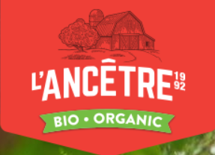
Environmentally friendly cheese
Different kinds of production
Offers healthy, tasty, organic cheeses produced in Quebec using environmentally friendly agricultural practices.
Source: https://fromagerieancetre.com/fr/fromages/

Slide 13
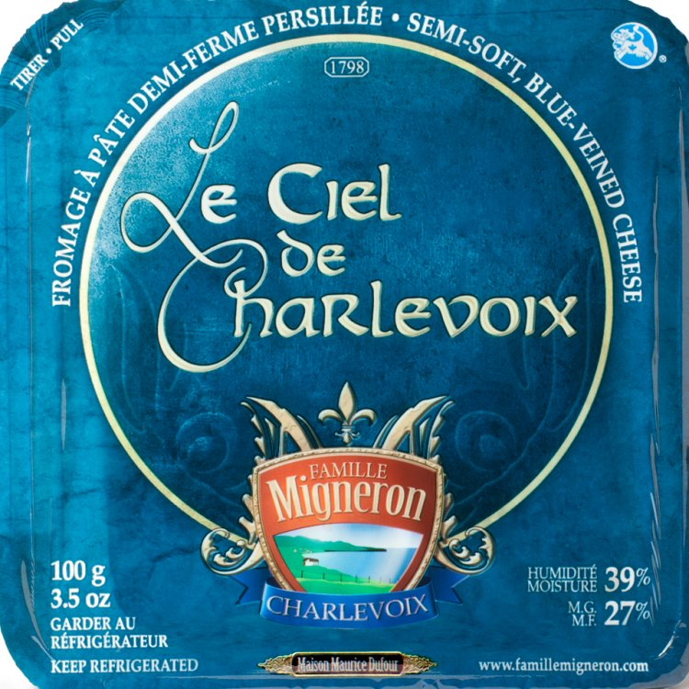
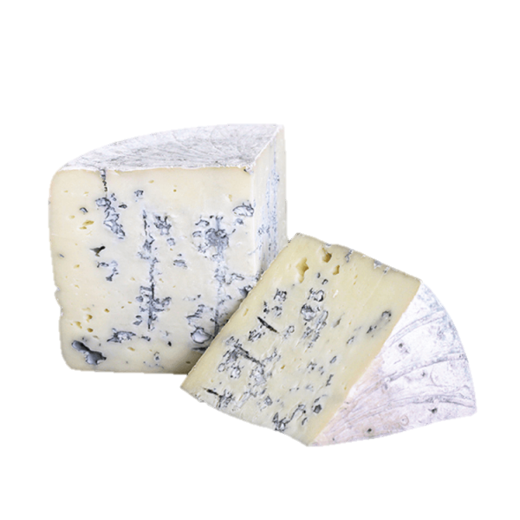
Maison d’affinage Maurice Dufour
A poetic name
Ciel de Charlevoix, a cheese made from raw cow’s milk dotted with Penicillium roqueforti. Its spotted appearance brings to mind the Charlevoix skies.
Source: https://www.ourcheeses.com/directory/le-ciel-de-charlevoix

Slide 14
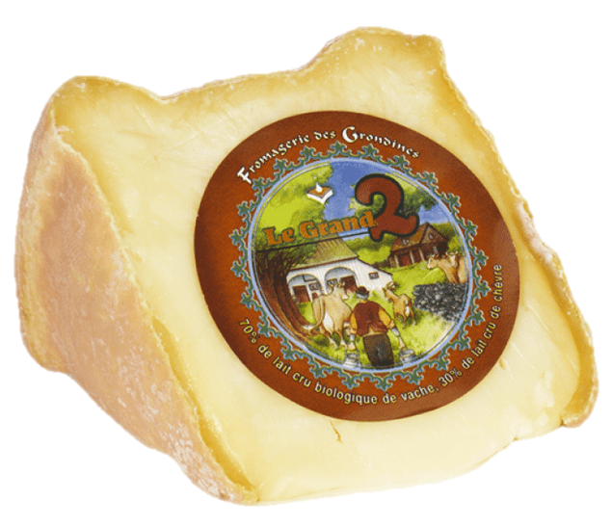
A meaningful name
Its name, Le Grand 2, has a double meaning. It’s a reference to both the two types of milk it is made from, as well as the cheese dairy’s address, Rang 2 in Grondines.
The drawing on the label represents “milking time”, and was created by Robert Julien, a local artist.
https://www.fromagesdici.com/fr/fromages/145/le-grand-2

