Slide 1
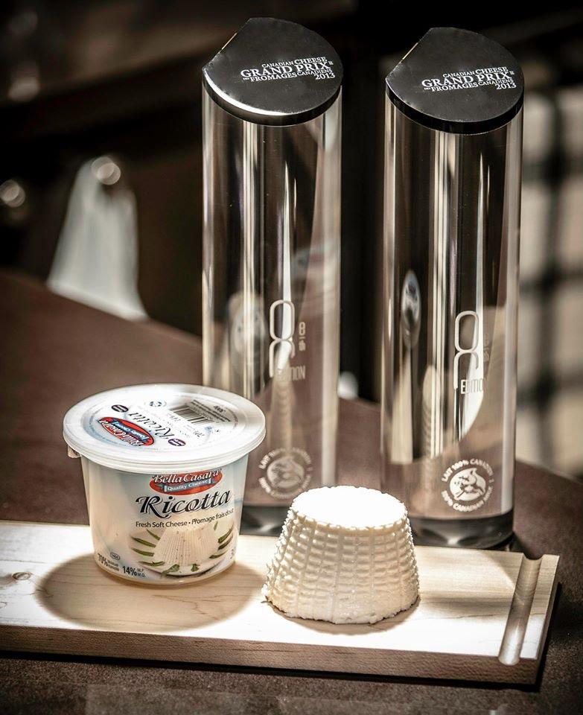
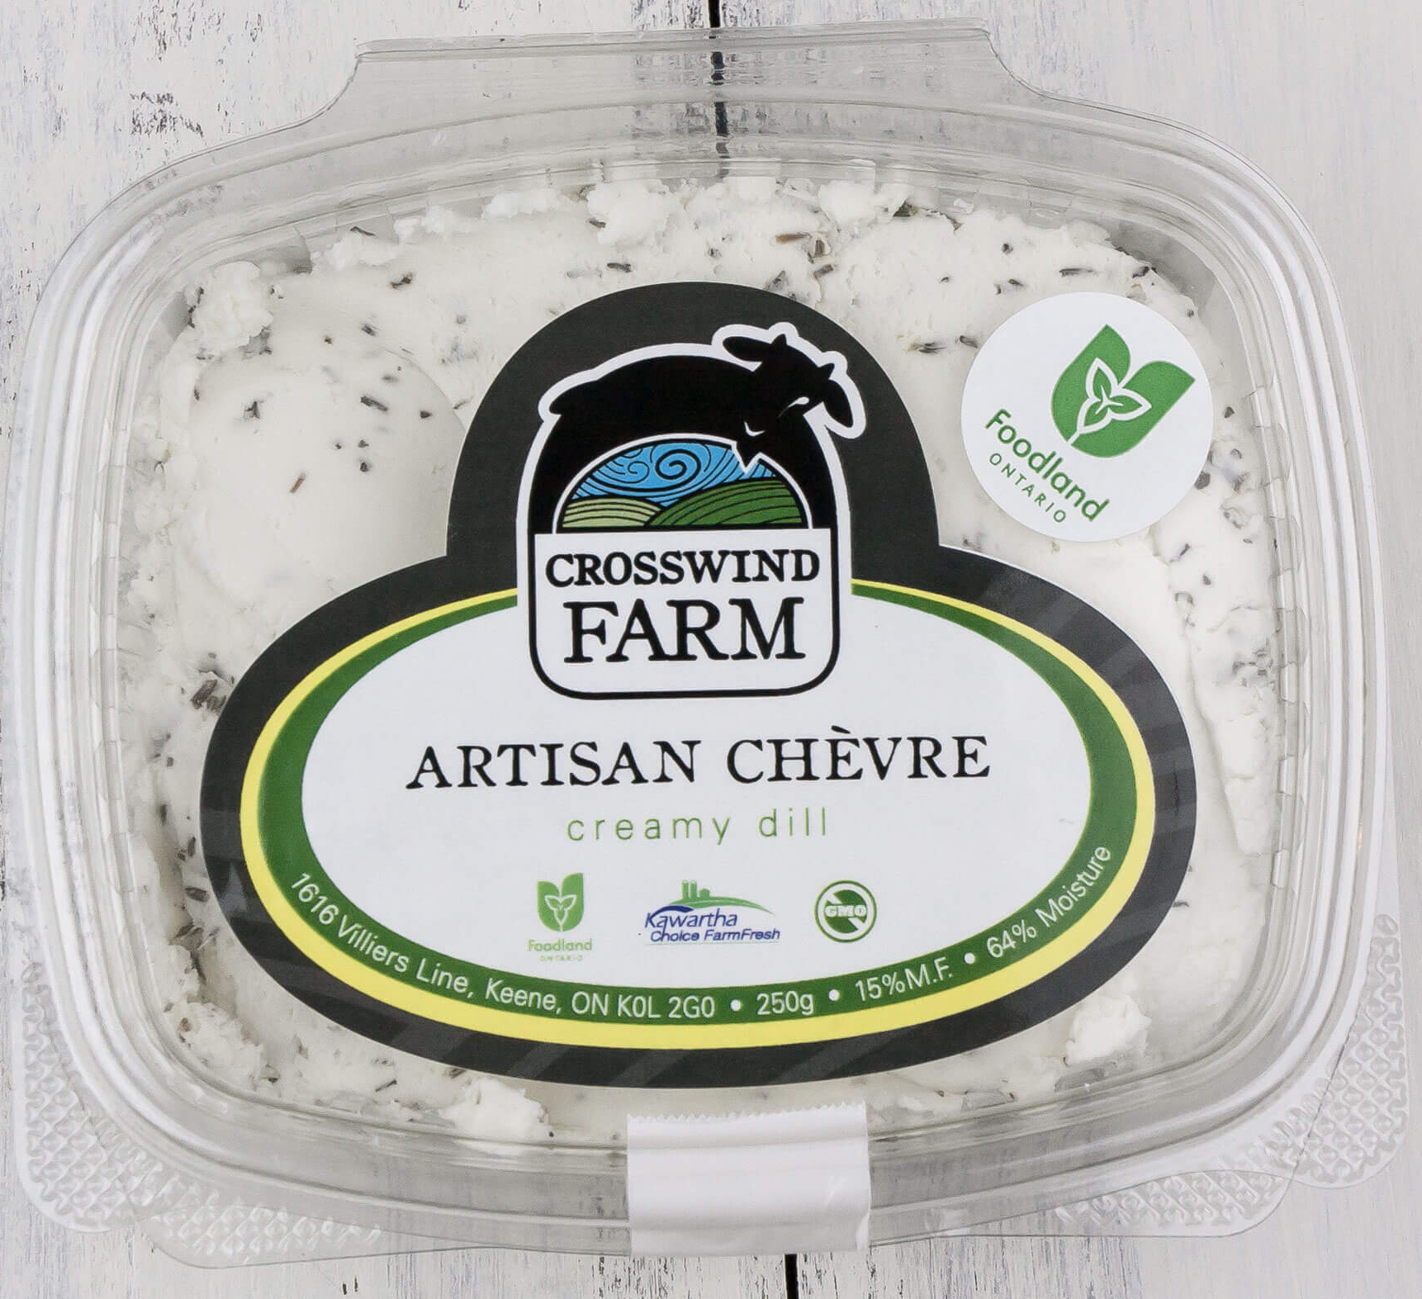
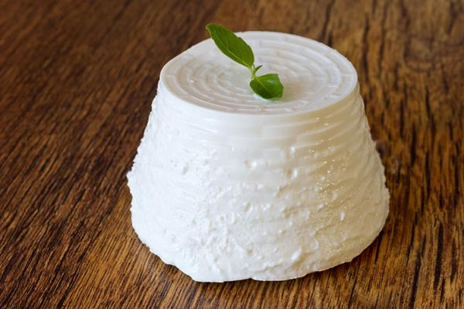
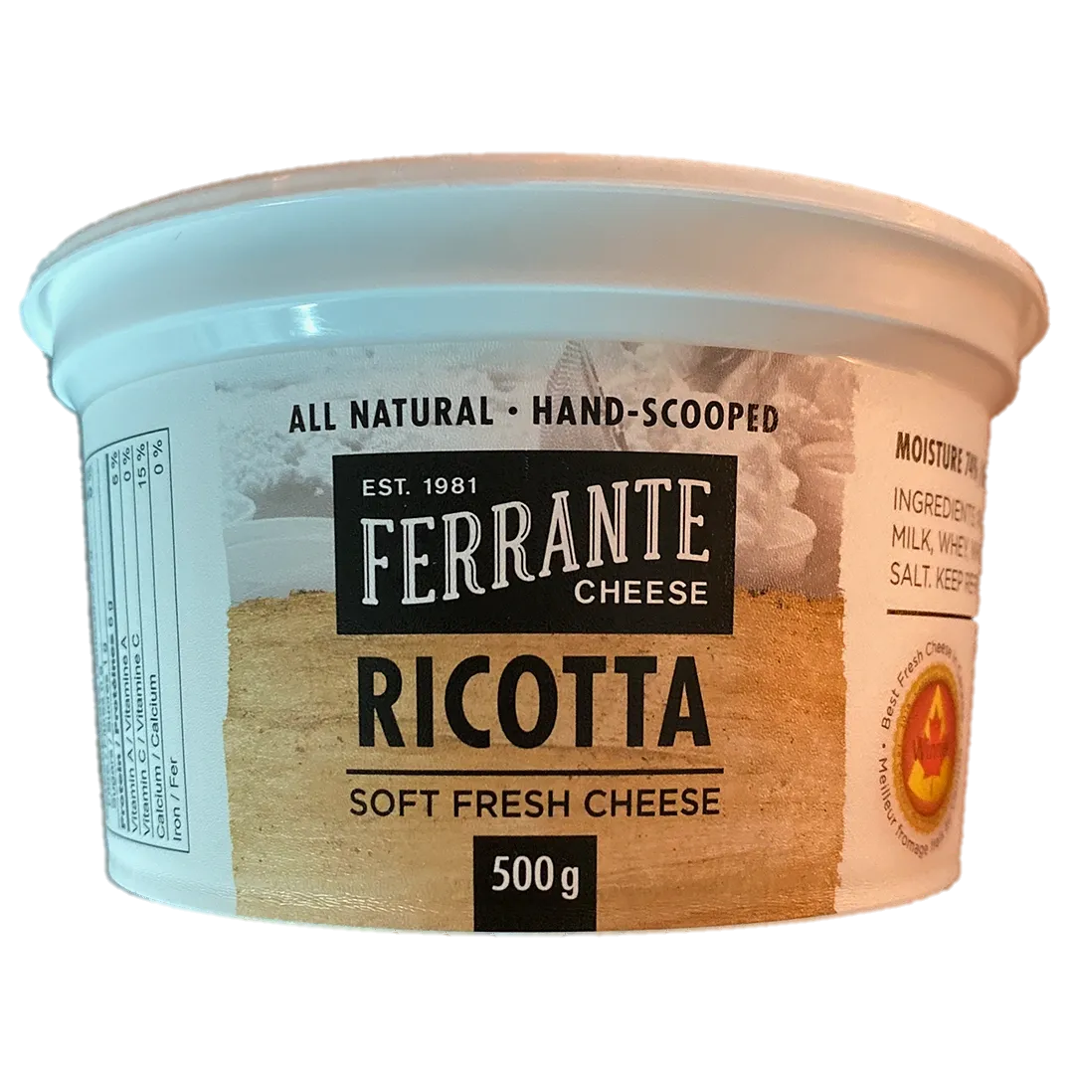
Fresh cheese
Fresh cheese
Fresh cheese
1
1
1
1
Cottage
Ricotta
Ricotta
Ricotta by Bufflonne de maciocia
Bella Casara by Quality Cheese
Artisan Chèvre by Crosswind Farm
introduction
Source: https://www.bufalamaciocia.ca/fr/nos-produits/
Source: https://qualitycheese.com/our-story/
Source: http://crosswindfarm.ca/chevre/
Fresh cheese
Fresh cheese
Fresh cheese
1
1
1
Ricotta
Goat cheese
Boursin
Ricotta – Ferrante Cheese
Cranberry and cinnamon by Mariposa Farm
Apple and maple Boursin
Source: https://ferrantecheese.com/our-cheese
Source: https://mariposadairy.ca/retail-chevre/
Source: https://www.boursin.ca/produits/

Slide 2
Artisan Chèvre by Crosswind Farm
Bella Casara by Quality Cheese
La Ricotta de Bufflonne
Milk: goat, farm-fresh, pasteurized
Colour: white
Taste: refined, delicate balanced
Aroma: milky
Texture: soft and creamy
Milk: cow, pasteurized
Colour: white
Taste: refined, delicate balanced
Aroma: milky
Texture: creamy
Milk: buffalo, pasteurized
Colour: bright white
Taste: mild and creamy, with a slight tang
Aroma: strong, fresh milk Texture: velvety
Canadian Cheese Grand Prix Grand Champion 2013
Boursin
Apple and Maple
Goat cheese – Cranberry and cinnamon by Mariposa Farm
Ricotta – Ferrante Cheese
Milk and cream: cow, pasteurized
Colour: ochre white
Taste: delicate, balanced
Aroma: apple and maple Texture: creamy and crumbly
Milk: goat, pasteurized
Colour: bright white
Taste: slightly acidic
Aroma: milky
Texture: creamy
Milk: cow, pasteurized
Colour: white
Taste: refined, delicate balanced
Aroma: milky
Texture: soft and creamy
Canadian Cheese Grand Prix Grand Champion 2019

Slide 3
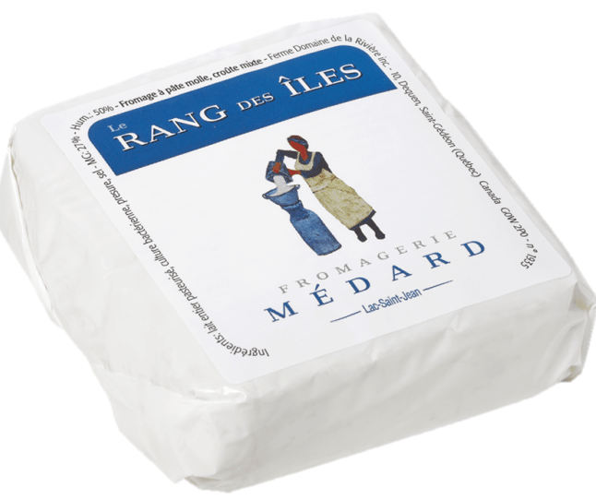
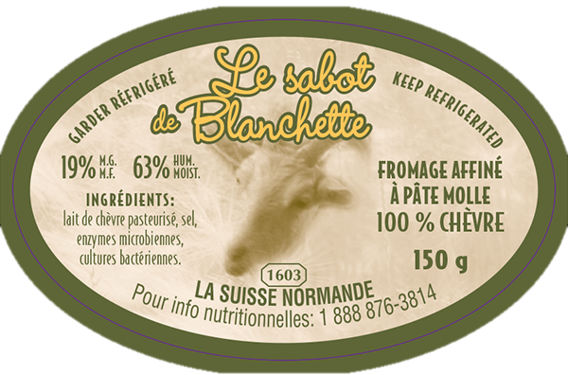
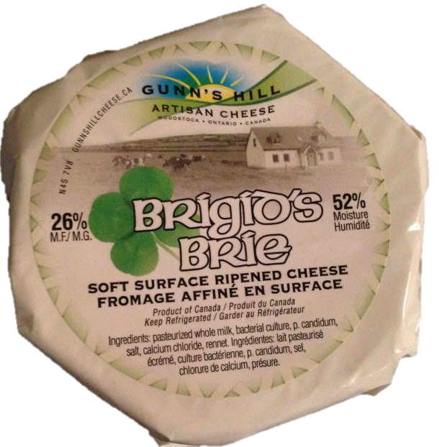
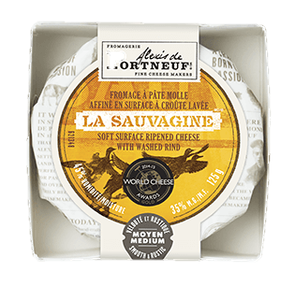
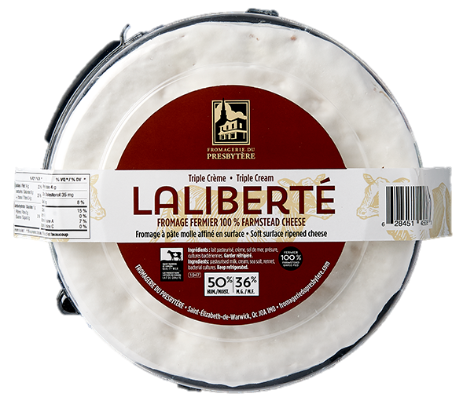
Soft cheese
Soft cheese
Soft cheese
2
2
2
1
Cheese with mixed rind
Bloomy rind
Soft cheese with natural rind
Le sabot de Blanchette by Fromagerie la suisse normande
Le rang des îles by Fromagerie Médard
Figaro by Glengarry Fine Cheese
Source: http://www.lasuissenormande.com/fromage.php?lang=fr&from=sabot
Source: https://fromageriemedard.ca/
Source: http://glengarryfinecheese.com/index.htm
Soft cheese
Soft cheese
Soft cheese
2
2
2
Brie
Brie
Triple Cream
La sauvagine by Fromagerie Alexis de Portneuf
Laliberté by Fromagerie du Presbytère
Brigid's Brie by Gunn’s Hill Artisan Cheese
Source: https://www.gunnshillcheese.ca/artisan-cheese/our-artisan-cheese/
Source: https://www.alexisdeportneuf.com/fr-ca/produits/pates-molles/la-sauvagine
Source: https://www.fromageriedupresbytere.com/

Slide 4
Le rang des îles by Fromagerie Médard
Le sabot de Blanchette by Fromagerie la suisse normande
Figaro de Glengarry Fine Cheese
Milk: cow, pasteurized
Rind: bloomy
Colour: white
Taste: soft, milky and fresh
Aroma: fresh bread
Texture: creamy
Milk: cow, pasteurized Colour: clarified butter
Taste: roasted notes
Aroma: vegetal (mushrooms and turnips) lactic (butter) and nuts
Texture: rind; soft and supple
Milk: goat, pasteurized
Colour: whitish rind
Taste: soft and subtle goat cheese flavour
Aroma: floral, lactic, acidic
Texture: velvety and creamy
International Cheese Competition – Sial 2019
Caseus Award 2018
Canadian Cheese Grand Prix 2016
Laliberté by Fromagerie du Presbytère
La sauvagine by Fromagerie Alexis de Portneuf
Brigid's Brie by Gunn’s Hill Artisan Cheese
Grand Champion Canadian Cheese Grand Prix 2019
Milk: cow, whole, pasteurized
Rind: bloomy
Colour: butter
Taste: milky with floral and mushroom notes
Aroma: fresh cream and mushrooms
Texture: unctuous
Milk: cow, pasteurized
Rind: moist and supple
Colour: ivory
Taste: fresh butter with hints of mushroom
Aroma: milky
Texture: runny
Milk: cow, pasteurized Colour: white
Taste: delicate, balanced taste of malt and caramel
Aroma: fruity and malty
Texture: soft and creamy.
Winner – Canadian Cheese Awards 2018
Gold Medal – World Cheese Awards 2018

Slide 5
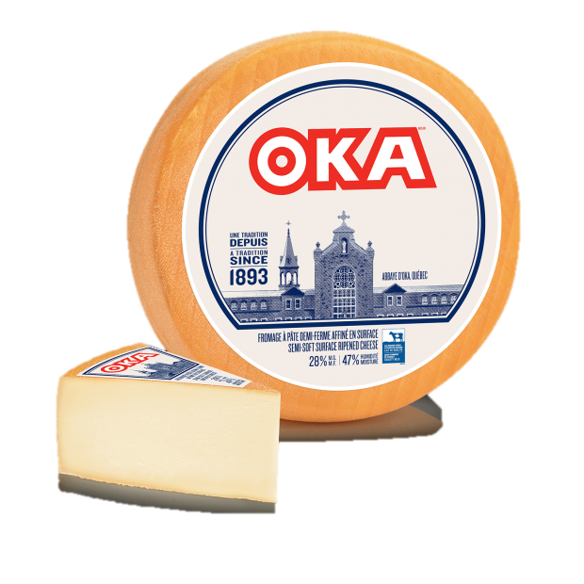
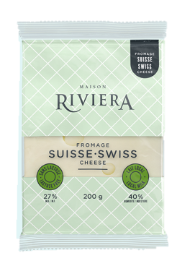
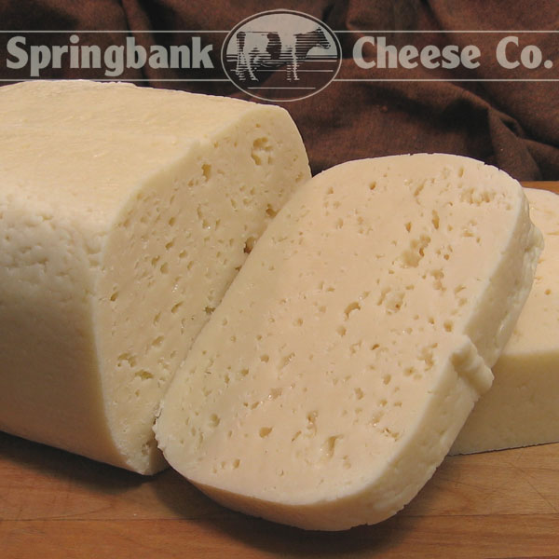
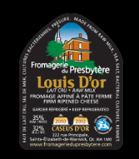
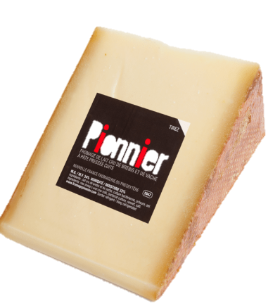
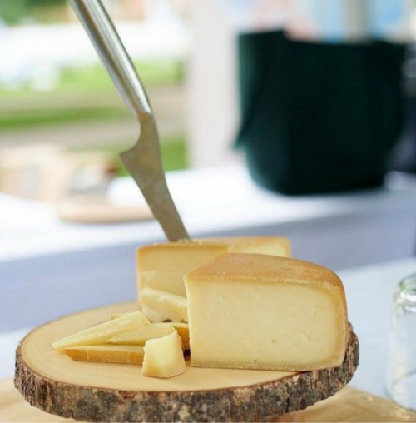
Semi-firm
Semi-firm
Semi-firm
3
3
3
1
Swiss type
Havarti
Oka
Oka by Agropur’s Fromagerie d’Oka
Swiss by Riviera
Havarti Creamy by Springbank Cheese Co.
Source https://www.fromageoka.ca/fr
Source https://riviera1920.com/fr/produit/suisse/?cat=les-fromages
Source https://springbankcheese.ca
Semi-firm
Semi-firm
Semi-firm
3
3
3
Gruyère
Gruyère type
Oka type
Louis d’Or by Fromagerie du Presbytère
Le Pionnier by Fromagerie Presbytère and Fromagerie de la Nouvelle France
Niagara Gold by Upper Canada Cheese
Source :https://www.fromageriedupresbytere.com/nos-fromages/#laliberte
Source https://fromagerienouvellefrance.com/
Source https://www.uppercanadacheese.com/niagaragold

Slide 6
Havarti Creamy by Springbank Cheese Co.
Swiss by Riviera
Oka by Agropur
Milk: cow, pasteurized Colour: ivory yellow
Taste: slightly sweet, almonds
Aroma: milk, hints of hazelnuts.
Texture: tender and supple
Milk: cow, pasteurized
Colour: yellow rind
Taste: subtle flavour of hazelnut and butter
Aroma: lactic, acidic
Texture: velvety and creamy
Milk: cow, pasteurized
Rind: yellowish
Colour: ivory with irregular holes
Taste: soft, milky, fresh butter
Aroma: fresh butter
Texture: creamy
Caseus winner 2016
Niagara Gold by Upper Canada Cheese
Le Pionnier by Fromagerie Nouvelle-France
Louis d’Or by Fromagerie du Presbytère
Grand Champion Canadian Cheese Grand Prix 2019
Milk: cow, pasteurized
Rind: golden with white spots of mould
Colour: butter
Taste: butter, grassy, slightly fruity
Aroma: moderately of earth, minerals and the farm.
Texture: semi-firm, washed rind, melt-in-your-mouth
Milk: cow and sheep, unpasteurized
Rind: washed, orange
Colour: white
Taste: milky and floral
Aroma: complex, butter, brown sugar and macadamia nuts
Texture: firm
Milk: raw cow
Colour: golden
Taste: complex, fruits and hazelnuts
Aroma: butter and cream
Texture: firm, pressed
Canadian Fine Cheese Award winner 2016
Caseus winner 2018
Best Swiss type cheese at Canadian Cheese Grand Prix 2015

Slide 7
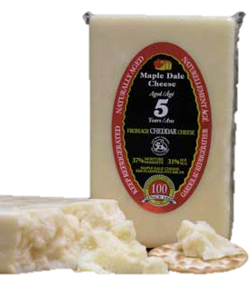
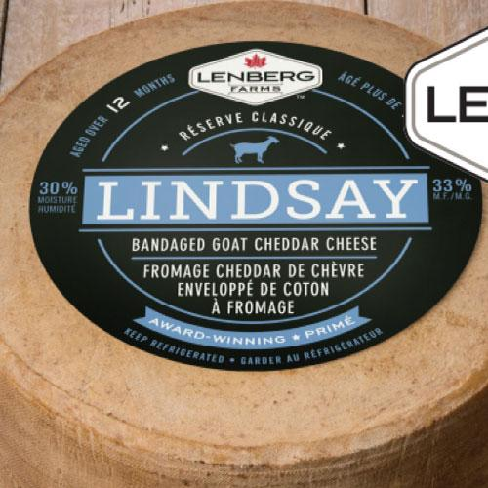
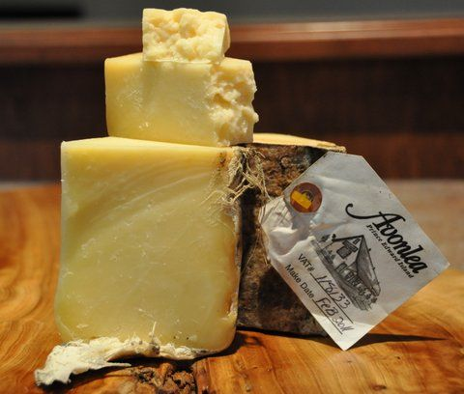
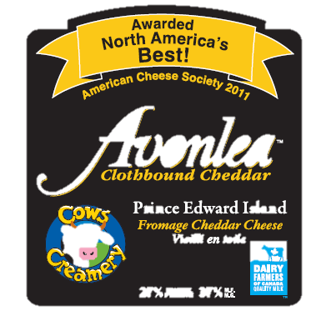
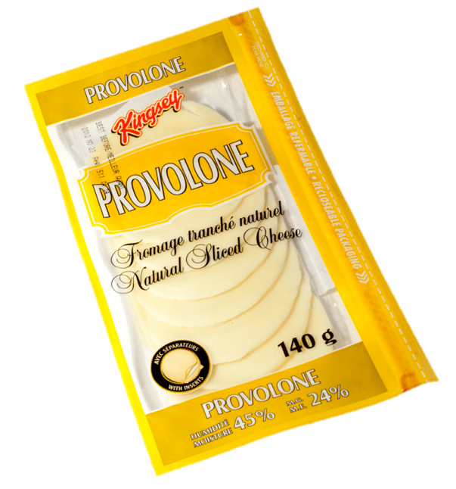
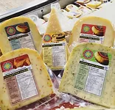
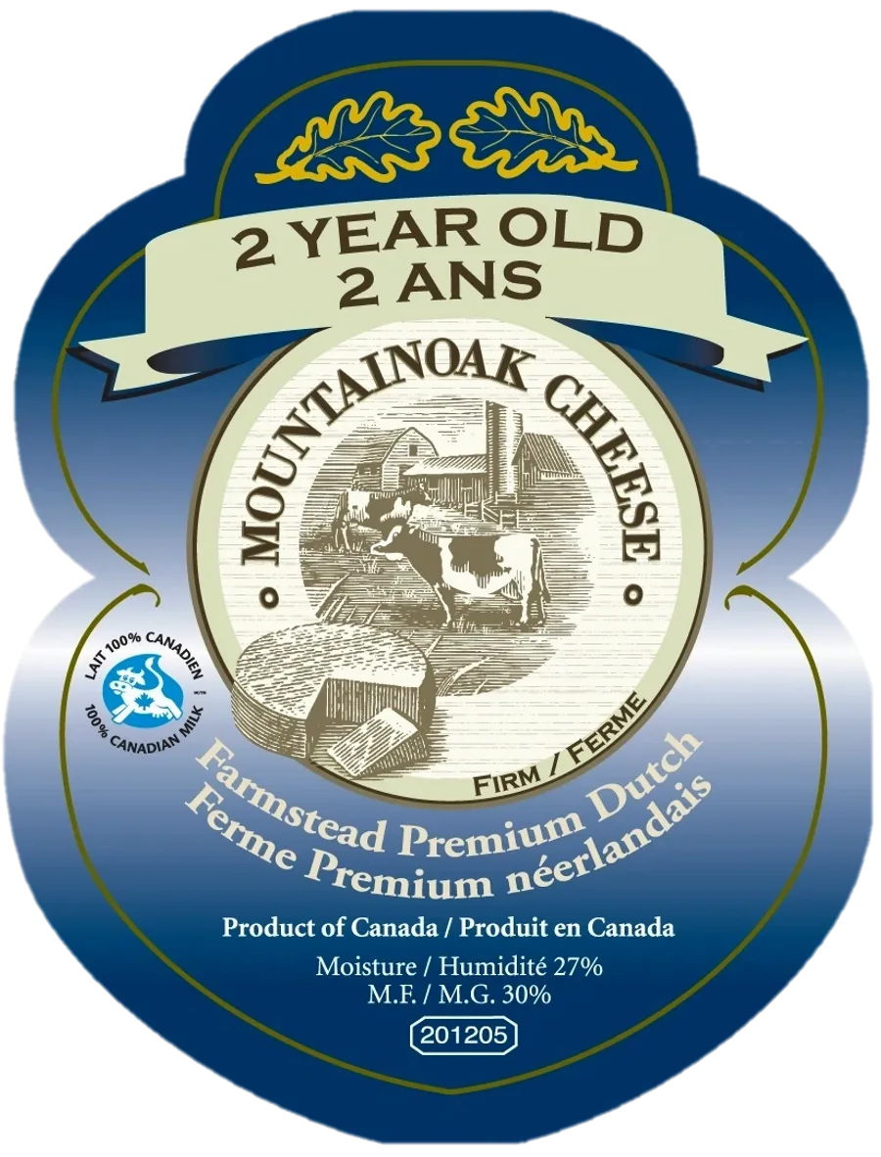
Firm
Firm
Firm
4
4
4
1
Cheddar
Cheddar
Cheddar
Avonlea Clothbound Cheddar by Cow’s Creamery
Maple Dale (5 years) by Maple Dale
Lindsay Bandaged Cheddar by Lenberg Farms
Source https://cowscreamery.ca/cheese/
Source http://mapledalecheese.ca/aged-cheddar-c9.php
Source https://mariposadairy.ca/lenberg-farms/
Firm
Firm
Firm
4
4
4
Gouda
Gouda
Provolone
Grizzly Gouda by Sylvan Star
Farmstead Gouda Cheese by Mountainoak cheese
Provolone by Kingsey (Saputo)
Source https://www.sylvanstarcheesefarm.ca/
Source https://mountainoakcheese.ca/our-products
Source https://www.stellacheese.com/en/our-cheese/provolone/provolone

Slide 8
Lindsay Bandaged Cheddar by Lenberg Farms
Maple Dale (5 years) by Maple Dale
Avonlea Clothbound Cheddar
Milk: cow, unpasteurized
Colour: pale yellow rind, greyish near rind
Taste: intense and complex, potato, hay with a hint of acidity
Aroma: vegetal and earthy Texture: firm, soft on the palate, slightly crumbly
Milk: goat, pasteurized
Rind: yellow
Colour: golden
Taste: soft, fruity and slightly tart at first, making way for slightly earthy notes, cooked milk and caramel, and a trace of tanginess that remains on the tongue
Aroma: earth and baked milk Texture: firm, crumbly
Milk: cow, thermised
Colour: pale yellow, dry appearance
Taste: fruity (tangerine and lemon) lactic (yogurt)
Aroma: fruity with notes of dried apple and wine
Texture: firm, sticks to the palate
3rd place American Cheese Society Competition 2018
Best cheddar Canadian Cheese Awards 2016
Best cheddar Canadian Cheese Awards 2017
Provolone by Kingsey
Farmestead Gouda Cheese by Mountainoak cheese
Grizzly Gouda by Sylvan Star
Grand Champion Canadian Cheese Grand Prix 2019
Milk: raw cow, thermised
Colour: golden
Taste: intense milky taste with notes of caramel, nuts and salt
Aroma: milky
Texture: firm, but soft and creamy on the palate
Milk: cow, pasteurized
Colour: butter
Taste: milky, slightly sweet
Aroma: cooked milk and butter
Texture: firm and fibrous, compact and stretchy
Milk: cow
Rind: yellow film
Colour: pale yellow
Taste: fruity with floral notes Aroma: lactic and roasted Texture: semi-firm, creamier in the centre
Best Swiss type cheese at Canadian Cheese Grand Prix 2013

Slide 9
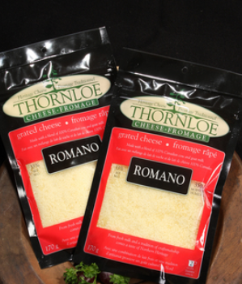
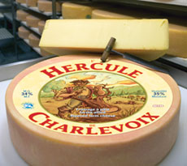
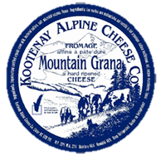
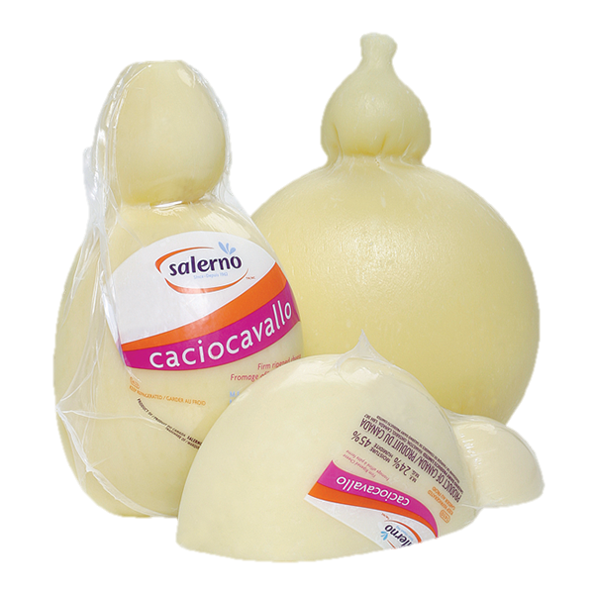
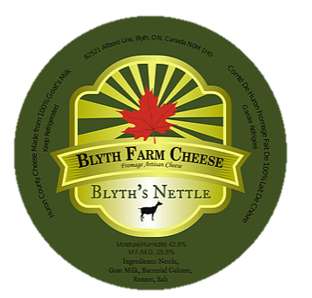
Hard
Hard
Hard
5
5
5
1
Romano
Italian Piave type
Hard cheese type
Romano by Thornloe Cheese (Gencor Foods)
Mountain Grana by Kootenay Alpine Cheese Company
Hercule by Laiterie de Charlevoix
Source https://www.thornloecheese.ca/fr/store/31/category_products
Source http://www.kootenaymeadows.com/kac/
Source http://Milkeriecharlevoix.com/hercule.html
Hard
Hard
Hard
5
5
5
Parmesan
Gruyère
Gouda type
Baby Parmesan by Silani Sweet Cheese
Caciocavallo by Salerno Dairy Products
Blyth’s Nettle by Blyth Farm Cheese
Source https://www.salernodairy.com/fr/produits/fromages-a-pate-ferme/fromage-caciocavallo
Source https://www.blythfarmcheese.ca/products
Source

Slide 10
Hercule by Laiterie de Charlevoix
Mountain Grana by Kootenay Alpine Cheese Company
Romano by Thornloe Cheese (Gencor Foods)
Milk: cow, thermised
Rind: coppery pink
Colour: dark yellow
Taste: nuts, butter and grain, fruity finale.
Aroma: butter and farm
Texture: hard and grainy, melt-in-your-mouth
Milk: cow and goat, pasteurized
Colour: rich creamy-yellow Taste: salty, strong and tangy
Aroma: floral, lactic, acidic
Texture: hard, grainy and crumbly
Milk: cow, unpasteurized Colour: white, straw
Taste: moderate with notes of fruits and nuts, tangy finale.
Aroma: lactic, milk and melted butter
Texture: dense, grainy and crumbly
Caseus Award 2018
Canadian Cheese Grand Prix 2016
Caseus Award 2016
Blyth’s Nettle by Blyth Farm Cheese
Caciocavallo by Salerno Dairy Products
Baby Parmesan by Silani Sweet Cheese
Grand Champion Canadian Cheese Grand Prix 2019
Milk: goat, pasteurized
Colour: butter
Taste: grassy
Aroma: butter and grass
Texture: firm
Milk: cow pasteurized
Rind: dry, yellow
Colour: ivory
Taste: butter, almonds Aroma: milky
Texture: firm, fibrous
Milk: cow, pasteurized
Colour: golden
Rind: natural, smooth and shiny
Taste: sharp and tangy with detectable salinity
Aroma: lactic
Texture: firm, grainy

Slide 11
_______
_______
_______
6
6
6
1
Mystery
Mystery
Mystery
Cheese dairy
Cheese dairy
Cheese dairy
Source
Source
Source
_______
_______
_______
6
6
6
Mystery
Mystery
Mystery
Cheese dairy
Cheese dairy
Cheese dairy
Source
Source
Source

Slide 12
Milk:
Colour:
Taste:
Aroma:
Texture:
Milk:
Colour:
Taste:
Aroma:
Texture:
Milk:
Colour:
Taste:
Aroma:
Texture:
Milk:
Colour:
Taste:
Aroma:
Texture :
Milk:
Colour:
Taste:
Aroma:
Texture:
Milk:
Colour:
Taste:
Aroma:
Texture:

