Slide 1
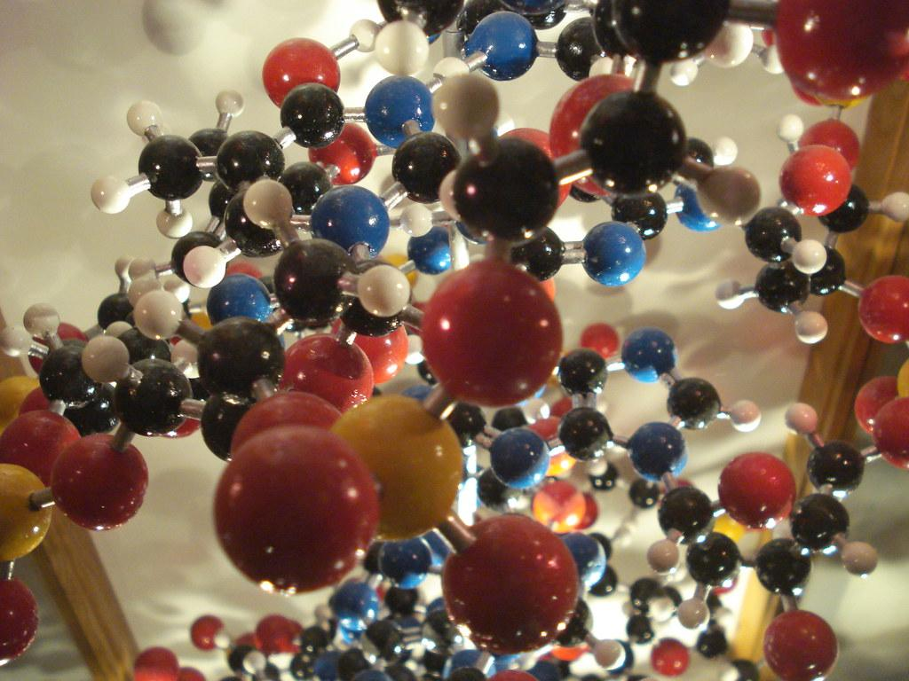
Enzymes in milk production
Notes:
Cheese is obtained through complete or partial coagulation of the milk through the action of an appropriate coagulating agent and drainage
https://fabriquetonfromage.com/

Slide 2
Rennet
A mix of pepsin and chymosin
Extracted from the 3rd stomach pouch of young cattle (abomasum)
Pepsin
Responsible for less than 15% of total coagulant activity
Produced as an inactive precursor: pepsinogen
Becomes active after acidification
Has a high proteolytic activity and a low coagulant activity
Stable at pH 5 to 5.5
Optimal enzymatic activity at pH 1.8
Denatured at temperatures of 70°C
Chymosin
Main coagulation agent (Mahaut et al., 2003)
Responsible for at least 85% of total coagulant activity
Holoproteins
Stable at pH 5 to 6
Optimal activity at ph 5
Inactivity at pH 8
Optimal action temperature 40°C
Denatured at temperatures of 61°C

Slide 3
Fermenting chymosin
Obtained through the development of genetic engineering.
Produced by microorganisms by cloning the gene responsible for the production of chymosin.
The most commonly used microorganisms are Escherichia coli, Kluyveromyces and Aspergillus.

Slide 4
Replacement enzymes
Must meet the following criteria:
Good water solubility.
Very light or inexistent odour and colour.
Good coagulating activity and reasonable shelf life.
No toxicity for the consumer and a high degree of purity to avoid any accidental proliferation of undesirable microorganisms.
Optimal cheese yield.
Plant-based coagulant
Plant proteases can hydrolyze α, β and κ caseins, which can cause excessive acidity.
Ex.: extracts from lemon, pineapple, ginger flower, fig, papaya…
Animal-based coagulant
Protease from sheep, pork, rabbit and even seal.
Fungus-based coagulant
Research on Mucor pusillus and M. miehei enzymes.

Slide 5
Milk coagulation
Transformation of liquid milk into a gel, called coagulum or curd, by the destabilization of the original micellar state of the caseins which flocculate and then weld to form a lactic clot or rennet.
Contains more or less fat, minerals, water and soluble elements, depending on the agent used.
The type of coagulation has a direct impact on cheese yields.
Can be caused by acidification, by the action of an enzyme or by the combined action of both.
Three criteria to consider:
1) The setting time (flocculation time);
2) The rate (speed of firming);
3) The maximum firmness of the gel.

Slide 6
Types of coagulation
By acid
Long process
Modifies the physicochemical properties of casein micelles
At pH 5.2 start of coagulation
At pH 4.6 complete coagulation
Acidity increases the solubility of minerals in whey
By enzymes
Short process in three phases
Destabilization of micellar caseins
Aggregation of destabilized micelles
Formation of a gel
Combination
Combined action of the rennet and the acid
Notes:
PROTEINS - Changes in temperature, pH or salt alter the formation of micelles. The modifications lead to decalcify (demineralize) the casein micelles, which causes coagulation. There are 2 types of coagulation: 1. lactic coagulation caused by the action of lactic bacteria which decrease the pH by transforming lactose into lactic acid. 2. A pressure type of curdling caused by the addition of rennet which hydrolyzes the casein -K which is responsible for the stability of micelles.
So cheese is a reorganization of the caseins in the milk.
The protein content is the most important factor on the cheese yield; 1 g of protein for 0.8 to 0.9 g of water for a pressed cheese and up to 3 g for a fresh cheese - in comparison, 1 gram of fat for 0 to 0.2 g of water.
During ripening, caseins are hydrolyzed into small fragments (polypeptides, peptides and amino acids) by proteolytic enzymes (e.g., chymosin), bacterial enzymes and enzymes naturally present in milk. These enzymes are responsible for the appearance of fruit, floral or bitter flavours. The ammonia smell of some varieties is caused by the action of surface fungus enzymes.
Whey proteins do not coagulate in the presence of chymosin (enzyme). They remain in the whey but can coagulate under the influence of the temperature. The temperature denatures part of the proteins which will allow the retention in the matrix. The whey proteins have the property of retaining water, which can affect the cheese’s texture and flavour. N.B. Ricotta cheese is made from whey proteins.
LACTOSE
The gradual transformation of lactose contributes to the decrease of pH, favours coagulation, forces the demineralization of casein micelles, favours the formation of curds, and inhibits the growth of certain microorganisms.
Note: lactose is mostly eliminated during the draining period. The remaining lactose is transformed into lactic acid. Lactose can cause browning of the cheese when subjected to heat (Maillard reaction).

Slide 7
Coagulation factors
Enzyme concentration
Inversely proportional to the enzyme concentration
Temperature
Below 10°C, no coagulation.
Between 10 and 20° C, coagulation is slow.
Over 20°C, it increases progressively up to 40-42°C.
Over 65°C, there is no coagulation, the enzyme is inactive.
pH
Lower pH brings a shorter coagulation time
CaCl₂ content
Increase in micelle size
Reduced coagulation time
Notes:
PROTEINS - Changes in temperature, pH or salt alter the formation of micelles. The modifications lead to decalcify (demineralize) the casein micelles, which causes coagulation. There are 2 types of coagulation: 1. lactic coagulation caused by the action of lactic bacteria which decrease the pH by transforming lactose into lactic acid. 2. A pressure type of curdling caused by the addition of rennet which hydrolyzes the casein -K which is responsible for the stability of micelles.
So cheese is a reorganization of the caseins in the milk.
The protein content is the most important factor on the cheese yield; 1 g of protein for 0.8 to 0.9 g of water for a pressed cheese and up to 3 g for a fresh cheese - in comparison, 1 gram of fat for 0 to 0.2 g of water.
During ripening, caseins are hydrolyzed into small fragments (polypeptides, peptides and amino acids) by proteolytic enzymes (e.g., chymosin), bacterial enzymes and enzymes naturally present in milk. These enzymes are responsible for the appearance of fruit, floral or bitter flavours. The ammonia smell of some varieties is caused by the action of surface fungus enzymes.
Whey proteins do not coagulate in the presence of chymosin (enzyme). They remain in the whey but can coagulate under the influence of the temperature. The temperature denatures part of the proteins which will allow the retention in the matrix. The whey proteins have the property of retaining water, which can affect the cheese’s texture and flavour. N.B. Ricotta cheese is made from whey proteins.
LACTOSE
The gradual transformation of lactose contributes to the decrease of pH, favours coagulation, forces the demineralization of casein micelles, favours the formation of curds, and inhibits the growth of certain microorganisms.
Note: lactose is mostly eliminated during the draining period. The remaining lactose is transformed into lactic acid. Lactose can cause browning of the cheese when subjected to heat (Maillard reaction).

Slide 8
Sources
Mahaut M., Jeantet R. et Brulé G., (2003). Initiation à la technologie fromagère. Paris, Lavoisier, Technique et documentation, Lavoisier, France; p 24-102.
“Extraction et purification d’une protéase coagulant le lait ...” http://dspace.univ-km.dz/xmlui/bitstream/handle/123456789/1969/Extraction%20et%20purification%20d’une%20protéase%20coagulant%20le%20lait%20Extraite.pdf?sequence=1&isAllowed=y. Consulted on: August 6, 2020.

