Slide 1
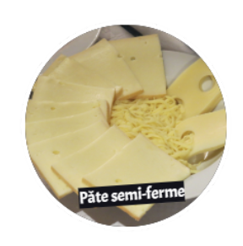
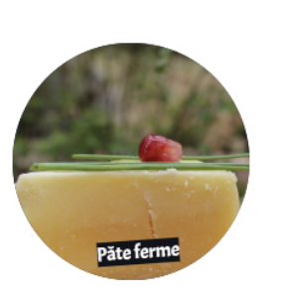
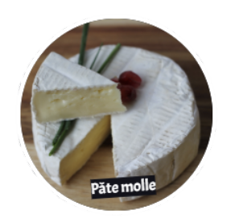
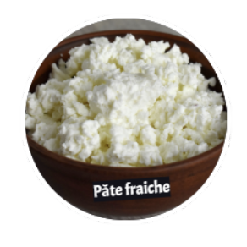
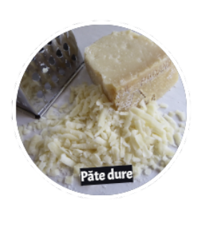
Tasting
Semi-firm cheese
Soft cheese
Hard cheese
The organoleptic properties of food are the properties perceived by the senses that allow us to recognize and appreciate them.
Fresh cheese
Firm cheese
Notes:
The images are taken from the animation
https://www.100kmfoods.com/blog/ontario-cheese-producers/
Canadian cheese awards - https://www.cheeseawards.ca/finalistsfinalistes2018/
https://www.cheeseawards.ca/accueil/

Slide 2
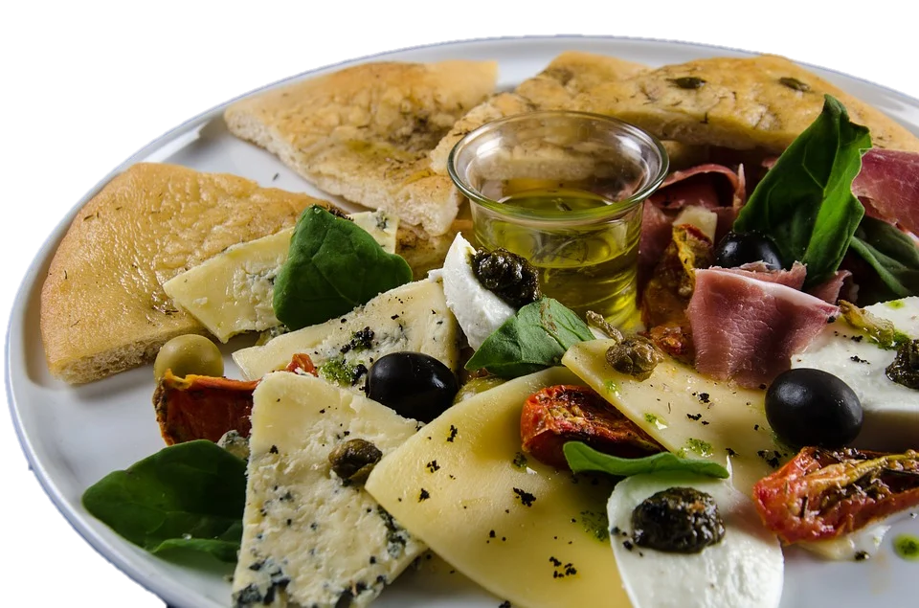
Multi-sensory analysis
The
5
senses
To truly appreciate a cheese, it should ideally be subjected to all the tasting steps: visual examination, auditory examination, tactile examination, olfactory examination and gustatory examination.
Visual examination makes it possible to identify the cheese family.
Sight: appearance, shape, condition, rind and cheese colour
Notes:
Sight allows us to anticipate some of the gustatory properties of cheeses. Observe the rind (colour, thickness, surface) and the inside of the cheese (colour, texture).

Slide 3
Multi-sensory analysis
The
5
senses
Tactile examination: touch helps determine the texture, consistency and temperature.
Auditory examination: hearing: noise, sounds made by the cheese when touched and placed in the mouth.
Olfactory examination: helps identify aroma, aromatic intensity and quality.
Smell: perceived by the nose through the air we breathe.
Notes:
Source Image : https://vimeo.com/238741789

Slide 4
Touch
Smell
Hearing
Power
Quality
Aroma
•Firm
•Sticky
•Stretchy
•Hard
•Runny
•Grainy
•Crumbly
•Unctuous
•Creamy
•Smooth
•Nonexistent
•Low
•Sufficient
•Intense
•Powerful
•Pleasant
•Unpleasant
•Simple
•Complex
•Fruity
•Vegetable
•Roasted
•Spicy
•Lactic

Slide 5
Multi-sensory analysis
The
5
senses
The taste test confirms or refutes visual impressions of texture through touch.
Taste is a complex concept, it is the combination of several factors:
➔ Flavours
➔ Aromas
➔ Trigeminal sensation
Notes:
https://vimeo.com/238741789
Taste is indeed an experience that involves all the senses, and much more. To improve your tasting skills, you need to understand the mechanisms that govern taste.

Slide 6
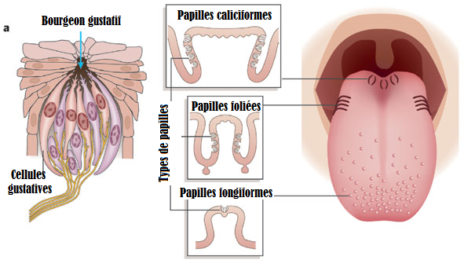
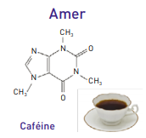
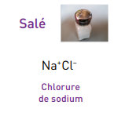
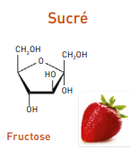
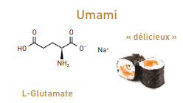
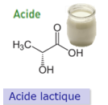
Taste - 20% of the flavour
•Sensations perceived by the gustatory organ (the tongue), stimulated by soluble substances.
•Approximately 10,000 papillae in the mouth, mainly on the tongue but also on the inside of the cheeks and the palate.
•3 types of papillae:
Fungiform: tip of the tongue
Foliate: sides of the tongue
Circumvallate: back of the tongue
•Each papilla is equipped with taste buds that have hundreds of taste receptors.
•The receptors can detect 5 basic types of flavours:
Acid
Sweet
Salt
Bitter
Umami (delicious complex taste compared to soy sauce)
Notes:
Image: https://proteinesauxproprietessurprenantes.files.wordpress.com/2013/03/papilles.png
Molecule image: https://www.mediachimie.org/sites/default/files/sens_p189.pdf
Umamic flavour is due to the different constituents of umami, namely glutamate, inosine monophasphate (IMP) and guanosine monophosphate
http://tpe-aromes.e-monsite.com/album/categorie-par-defaut/cinq-sens-gout.html
https://lebeartrotter.com/comment-fonctionne-gout/

Slide 7
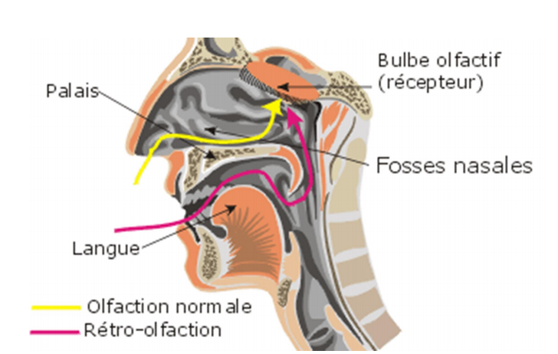
•Sensations perceived by the olfactory organ through the retronasal route during tasting (the product in the mouth).
•During chewing, volatile substances reach the receptors in the nasal cavity through the pharynx.
•The nose can distinguish many aromas and smells.
•There are nearly 20,000 different smells, each with at least ten (10) degrees of intensity.
•Sensitivity develops and evolves over time.
Aroma - 80% of the flavour
Notes:
The sense of smell plays a major role in tasting in general. Just think about when you have the flu and are congested, or pinch your nose while eating something and see how the taste is different.

Slide 8
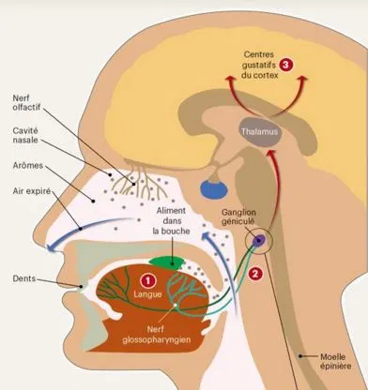
•Sensations associated with the trigeminal nerve pathway.
•Corresponds to what is perceived by the oral mucosa during contact (touching food with it).
• Includes sensations collected through the oral cavity or inside the nose, which do not come from the taste buds or olfactory cilia.
•E.g.: hot (pepper), fresh (menthol), tangy (soft drink), astringent (dryness).
Trigeminal sensations
Notes:
Image : https://lebeartrotter.com/comment-fonctionne-gout/

Slide 9
Notes:
http://depgbcreteil.blogspot.com/2016/06/lumami-5e-saveur-de-lagro-alimentaire.html

Slide 10
Fruity
Nuts
Citrus
Stone fruit
Exotic fruit
Taste
Spicy
Cinnamon
Aniseed
Clove
Power
Quality
Inexistant
Low
Sufficient
Intense
Powerful
•Pleasant
•Unpleasant
•Simple
•Complex
Floral
Honey
Flower
Vanilla
Vegetal
Grass
Cereal
Wood
Lactic
Butter
Milk
Cream
Empyreumatic
Smoke
Coffee
Chocolate
Toasted bread
Confectionery
White sugar
Corn syrup
Brown sugar

Slide 11
More vocabulary
•Aftertaste: olfactogustative sensation, which appears after the product has been ingested and which differs from the sensations perceived when the product was in the mouth.
•Lasting impression: often complex persistence (more or less long or intense), associating aromas, elementary flavours and trigeminal sensations.

