Slide 1
Tasting

Slide 2
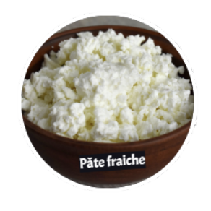
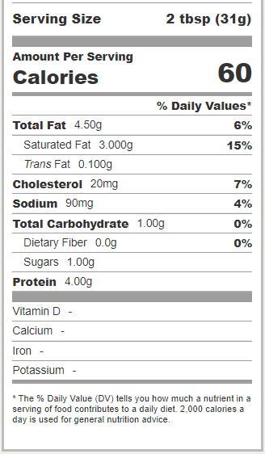
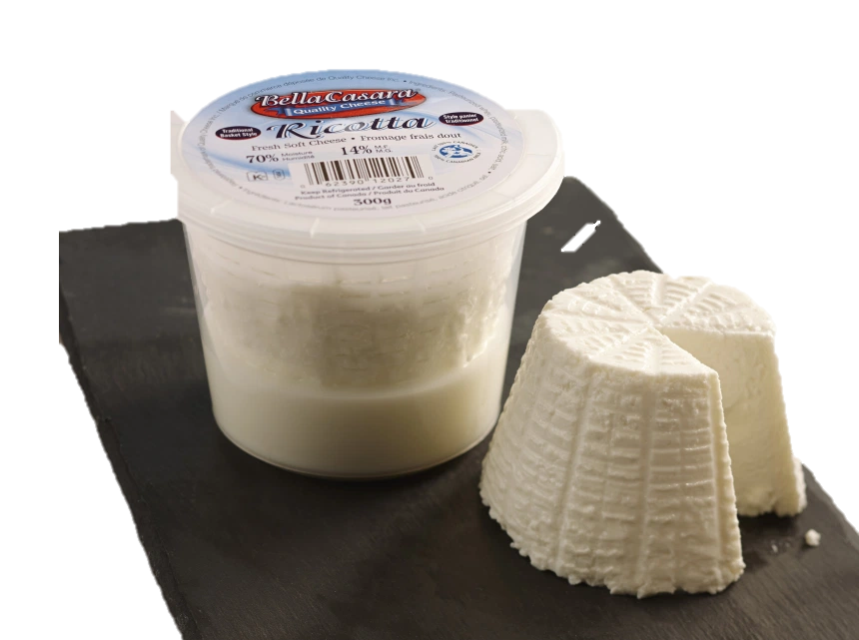
Fresh cheese
Fresh cheese
Fresh Cheese
1
Milk: pasteurized, buffalo
Colour: white
Aroma: strong milk aroma
Texture: creamy
Taste/flavour: lactic
Bella Casara Ricotta
Cheese dairy:
Quality Cheese
Sources: https://journalmetro.com/wp-content/uploads/2013/04/bouffe-ricotta1_c100.jpg?w=860
https://www.fatsecret.ca/calories-nutrition/bella-casara/ricotta/2-tbsp?frc=True
Notes:
Soft and creamy ricotta is made with pasteurized whey, pasteurized buffalo milk, citric acid and salt. Simple ingredients and expert know-how make for an incredible cheese. Perfect for stuffed pasta!

Slide 3
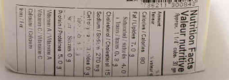
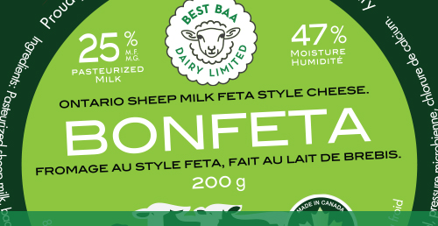
Fresh cheese
Fresh cheese
Fresh cheese
Milk: pasteurized or unpasteurized, sheep
Colour: white
Type: fresh
Aroma: soft
Texture: crumbly
Taste/flavour: lactic, acidic, lemon
1
Feta Style
Cheese dairy:
Baa Dairy
Sources: http://bestbaa.com/
https://www.fatsecret.ca/calories-nutrition/generic/brie-cheese

Slide 4
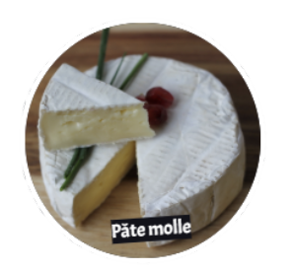
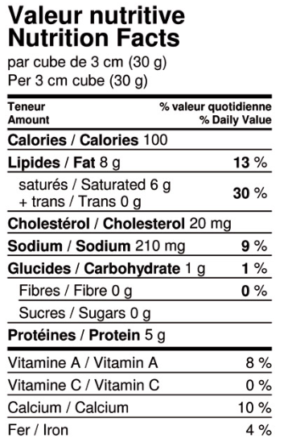
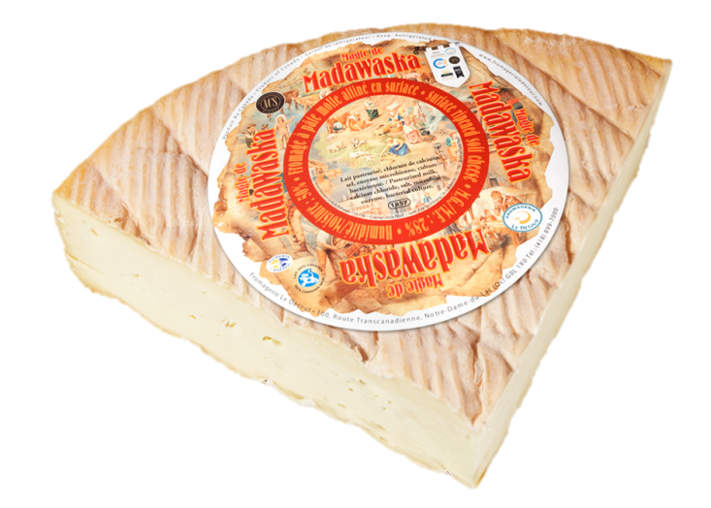
Soft Cheese
Soft cheese
Soft cheese
1
Milk: unpasteurized, cow
Colour: cream
Type: soft cheese with bloomy rind
Aroma: soft
Texture: creamy
Taste/flavour: lactic
Madawaska cheese
Cheese dairy:
Back Forty Artisan Cheese
Source: https://www.artisancheese.ca/product/madawaska/
https://fromagescda.com/en/products/117-magie-de-madawaska.html
Notes:
The Madawaska is a beautiful rustic cheese with a bloomy rind that offers a range of tastes and textures. From a chalky, slightly tangy centre to a soft, sweet and slightly salty cream under the rind, this cheese presents a unique taste and texture profile.
TASTING NOTES: A beautiful bloomy cheese with thick, cream-coloured surface flora, and a paste that’s chalky white at the heart and flowing ivory near the rind. Delicate, citric yogurt aromas lead to a melting sweetly mineral finish.

Slide 5
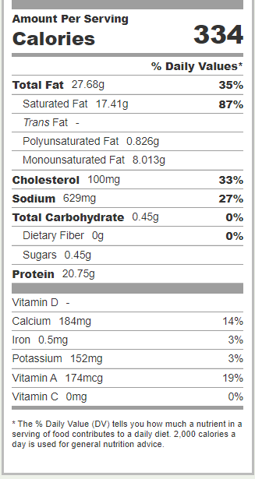
Soft cheese
Soft cheese
Soft cheese
Milk: pasteurized, cow
Colour: cream
Type: soft cheese with washed rind
Aroma: soft
Texture: supple, soft
Taste/flavour: lactic
1
Brigid’s Brie
Cheese dairy:
Gunn’s Hill’s
Source: https://www.gunnshillcheese.ca/artisan-cheese/our-artisan-cheese
https://www.fatsecret.ca/calories-nutrition/generic/brie-cheese
Notes:
This soft surface-ripened cheese is made with cow’s milk and is free from stabilizers and preservatives. That’s why it’s sold with an expiry date, each lot being ripened for six weeks to preserve its creamy consistency.

Slide 6
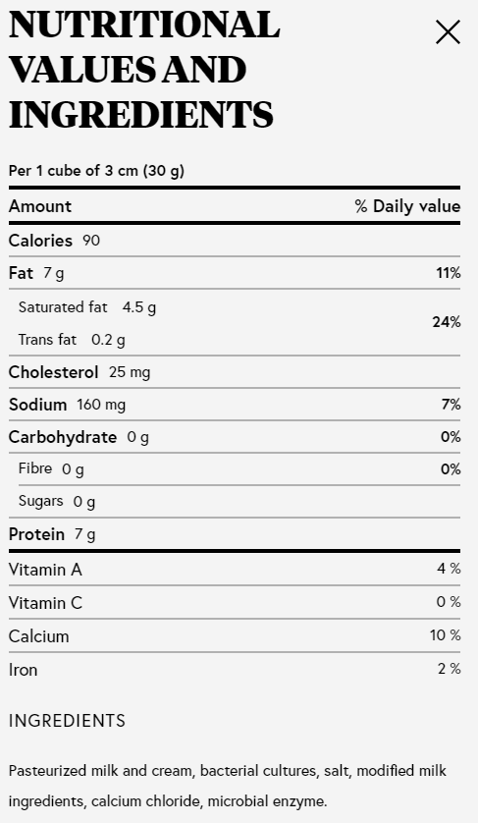
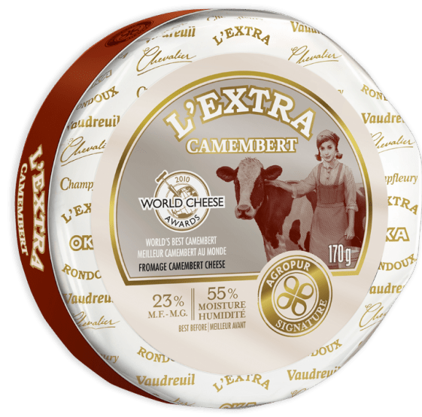
Soft cheese
Soft cheese
Soft cheese
Milk: pasteurized, cow
Colour: cream
Type: camembert, soft cheese, bloomy
Aroma: soft hazelnut
Texture: creamy
Taste/flavour: hazelnut, mushroom, lactic
1
L’extra
Cheese dairy:
Fromagerie de St-Hyacinthe-Agropur
Source: https://www.fromagesdici.com/fr/fromages/9/camembert-lextra
ttps://www.cheesebar.ca/cheese/lextra-camembert?_ga=2.71193360.1214144227.1622734345-1271938363.1622467499
Notes:
This soft surface-ripened cheese is made with cow’s milk and is free from stabilizers and preservatives. That’s why it’s sold with an expiry date, each lot being ripened for six weeks to preserve its creamy consistency.

Slide 7
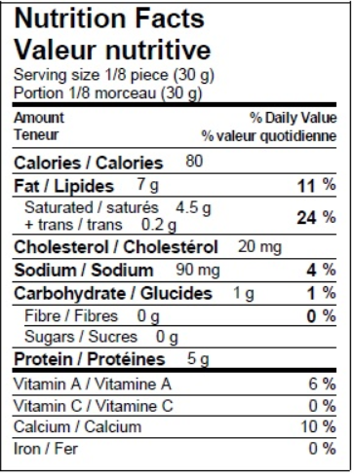
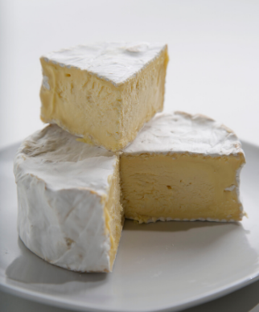
Soft cheese
Soft cheese
Soft cheese
Milk: pasteurized, cow
Colour: golden
Type: soft cheese, bloomy, white
Aroma: soft
Texture: creamy, silky
Taste/flavour: lactic, butter, truffles
1
Comfort cream
Cheese dairy:
Upper Canada Cheese
Source: https://www.uppercanadacheese.com/comfortcream
Notes:
Comfort Cream is a soft cheese with a soft bloomy rind, in the camembert style, with a silky, creamy, golden interior. Rich flavour of fresh truffles, with an intense, buttery palate and a long, tart finish.

Slide 8
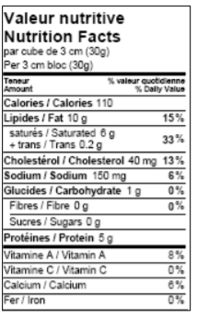
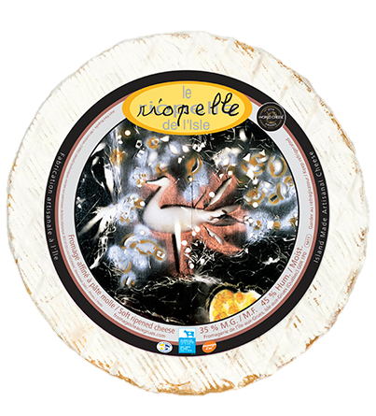
Soft cheese
Soft cheese
Soft cheese
Milk: cow, thermised
Color: ivory
Type: Soft cheese with bloomy rind
Aroma: soft, soft butter, mushroom
Texture: creamy, thin
Taste/flavour: lactic mushroom, vegetal
1
Riopelle de l’isle
Cheese dairy:
de l’île-aux-Grues
Source: https://fromagesduquebec.qc.ca/en/cheeses/cow-milk/fromagerie-de-lile-aux-grues/riopelle-de-lisle
https://www.fromagesileauxgrues.com/produits/le-riopelle-de-lisle/
Notes:
Comfort Cream is a soft cheese with a soft bloomy rind, in the camembert style, with a silky, creamy, golden interior. Rich flavour of fresh truffles, with an intense, buttery palate and a long, tart finish.

Slide 9
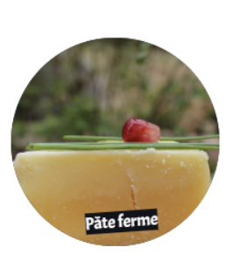
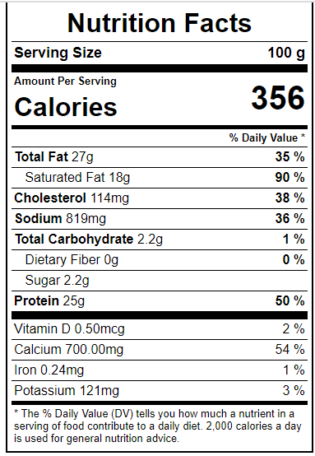
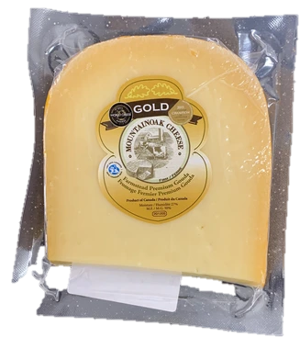
Semi-firm cheese
Semi-firm cheese
Semi-firm cheese
1
Milk: cow, pasteurized
Color: golden
Type: gouda
Aroma: soft caramel
Texture: creamy, smooth
Taste/flavour: caramel
Farmstead Gold
Cheese dairy:
Mountainoak Cheese
Source: https://mountainoakcheese.ca/our-products
https://www.nutritionvalue.org/Cheese%2C_gouda_nutritional_value.html
Notes:
A full-flavoured farmstead Gouda that exudes hints of butterscotch and caramel.
Farmstead Premium Dutch stands proudly among any products from the Netherlands. It has the same soft taste, creamy texture, and sparkling eyes. An excellent dessert cheese, it is also ideal for cooking, and melts incredibly well. The cheese is made from the freshest milk possible, only a few minutes after the last cow has been milked. The result is a true farmer’s cheese!

Slide 10
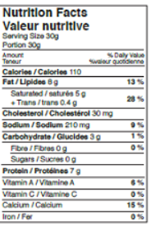
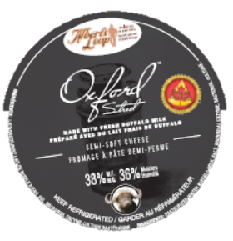
Semi-firm cheese
Semi-firm cheese
Semi-firm cheese
1
Milk: buffalo, pasteurized
Color: white, yellow rind
Type: gouda
Aroma: soft butter
Texture: smooth
Taste/flavour: butter, herb
Oxford Street Buffalo Gouda
Cheese dairy:
Quality cheese
Source: https://fromagescda.com/en/products/181-oxford-street.html
Notes:
A full-flavoured farmstead Gouda that exudes hints of butterscotch and caramel.
Farmstead Premium Dutch stands proudly among any products from the Netherlands. It has the same soft taste, creamy texture, and sparkling eyes. An excellent dessert cheese, it is also ideal for cooking, and melts incredibly well. The cheese is made from the freshest milk possible, only a few minutes after the last cow has been milked. The result is a true farmer’s cheese!

Slide 11
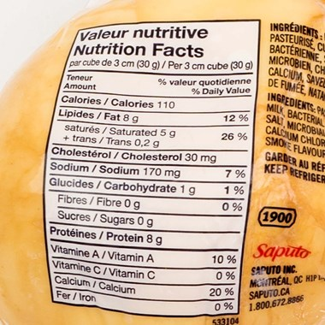
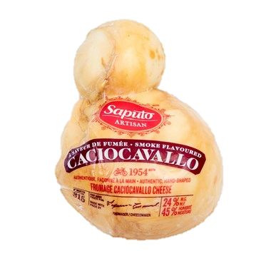
Firm cheese
Firm cheese
Firm cheese
1
Milk: cow, pasteurized
Color: golden
Type: gouda
Aroma: smoky, woody
Texture: melting
Taste/flavour: smoky
Caciocavallo
Cheese dairy:
Saputo
Source: https://mountainoakcheese.ca/our-products
https://www.nutritionvalue.org/Cheese%2C_gouda_nutritional_value.html
Notes:
A full-flavoured farmstead Gouda that exudes hints of butterscotch and caramel.
Farmstead Premium Dutch stands proudly among any products from the Netherlands. It has the same soft taste, creamy texture, and sparkling eyes. An excellent dessert cheese, it is also ideal for cooking, and melts incredibly well. The cheese is made from the freshest milk possible, only a few minutes after the last cow has been milked. The result is a true farmer’s cheese!

Slide 12
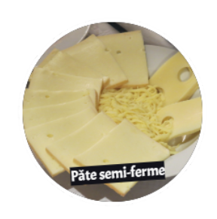
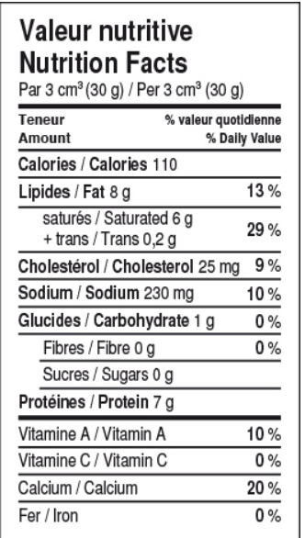
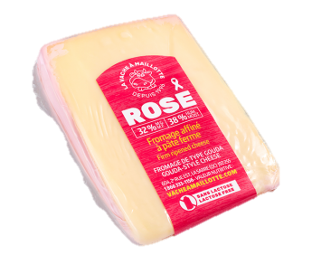
Firm cheese
Firm cheese
Refined-firm
Milk: cow, pasteurized
Color: ivory
Type: gouda, waxed rind
Aroma: lactic
Texture: supple
Taste/flavour: soft lactic, pink
1
Rose
Cheese dairy:
La vache à Maillotte
Source: http://www.vacheamaillotte.com/en/products/details.cfm?ProduitID=21
Notes:
Farmer cheese from pasteurized cow’s milk, with a subtle, slightly salty taste. Warm days and cool northern nights make for softer grass fed to the animals, which gives the milk an unmistakable Abitibi aspect and a unique rose flavour.

Slide 13
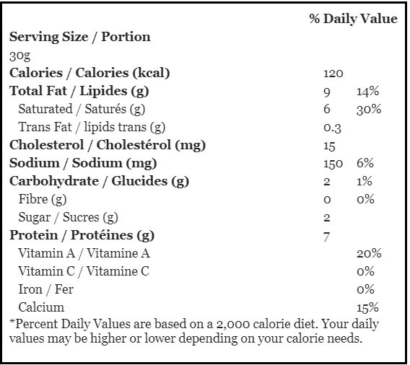
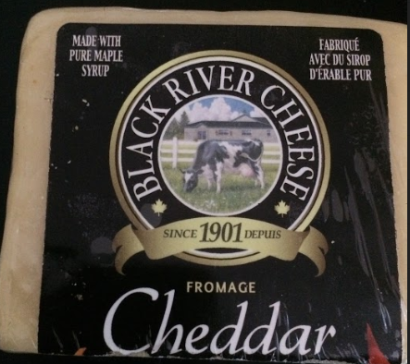
Firm cheese
Firm cheese
Firm cheese
Milk: cow, pasteurized
Color: white
Type: no rind
Aroma: soft
Texture: melt-in-your-mouth
Taste/flavour: sweet and salty
1
Maple cheddar
Cheese dairy:
Black River
Source: https://blackrivercheese.com/products/artisian-cheddars/maple-cheddar/
Notes:
When it comes to truly unique cheddar, there aren’t enough superlatives to describe the superb flavour of BLACK RIVER CHEESE COMPANY LTD. A superior blend of fine, medium-aged artisan cheddar and pure Prince Edward County maple syrup, this deliciously tantalizing cheddar puts your taste buds on edge. The savoury tones of the cheddar gently combine with the delicate sweetness of the maple syrup, creating an almost ambrosial taste sensation - one that leaves you wanting more as it melts in your mouth. Like a premium aged cheddar, our Maple Cheddar is a crowd pleaser with its sweet and savoury taste. Paired with a quality Chardonnay or contrasted with a rich Shiraz, it makes a delicious appetizer that will have your guests succumbing to its almost addictive flavour. Often used by some of Canada’s top chefs, this delicious cheddar lends itself to great culinary creativity. Take an old-fashioned grilled cheese sandwich to new heights using Black River Cheese Maple Cheddar, but don’t stop there! Put a new spin on eggs Benedict or eggs Florentine by using a maple cheddar sauce instead of the traditional hollandaise sauce. Add it to a Waldorf salad. Make cheese bread with this sauce. Serve it with peach or apple pie. Its culinary uses are as great as your imagination! 200 g or 280 g animal-free rennet-based.

Slide 14
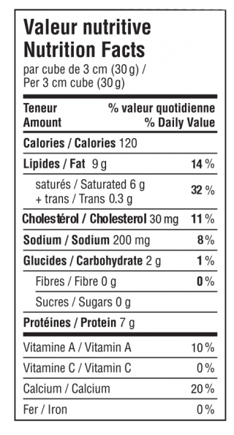
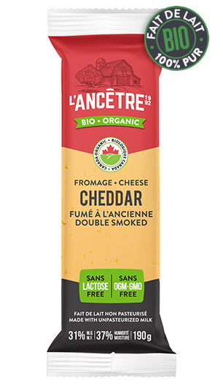
Firm cheese
Firm cheese
Firm cheese
Milk: bio, cow, unpasteurized
Color: brown, amber
Type: no rind
Aroma: smoky
Texture: firm and velvety
Taste/flavour: smoky, hazelnut, butter
1
Smoked Cheddar
Cheese dairy:
L’ancêtre
Source: https://fromagerieancetre.com/en/cheeses/double-smoked-cheddar/
Notes:
When it comes to truly unique cheddar, there aren’t enough superlatives to describe the superb flavour of BLACK RIVER CHEESE COMPANY LTD. A superior blend of fine, medium-aged artisan cheddar and pure Prince Edward County maple syrup, this deliciously tantalizing cheddar puts your taste buds on edge. The savoury tones of the cheddar gently combine with the delicate sweetness of the maple syrup, creating an almost ambrosial taste sensation - one that leaves you wanting more as it melts in your mouth. Like a premium aged cheddar, our Maple Cheddar is a crowd pleaser with its sweet and savoury taste. Paired with a quality Chardonnay or contrasted with a rich Shiraz, it makes a delicious appetizer that will have your guests succumbing to its almost addictive flavour. Often used by some of Canada’s top chefs, this delicious cheddar lends itself to great culinary creativity. Take an old-fashioned grilled cheese sandwich to new heights using Black River Cheese Maple Cheddar, but don’t stop there! Put a new spin on eggs Benedict or eggs Florentine by using a maple cheddar sauce instead of the traditional hollandaise sauce. Add it to a Waldorf salad. Make cheese bread with this sauce. Serve it with peach or apple pie. Its culinary uses are as great as your imagination! 200 g or 280 g animal-free rennet-based.

Slide 15
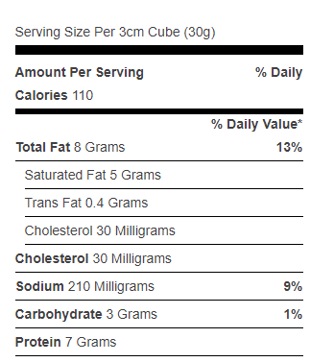
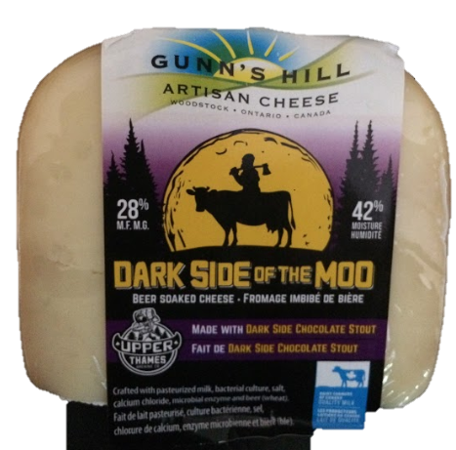
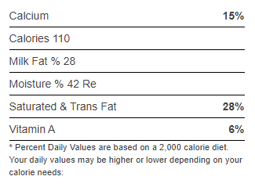
Firm cheese
Firm cheese
Firm cheese
Milk: cow, pasteurized
Color: white
Type: thin rind
Aroma: beer
Texture: creamy, smooth
Taste/flavour: buttery milk and beer
1
Dark side of the Moo
Cheese dairy:
Gunn’s Hill Artisan Cheese
Source: https://gunnshillcheese.ca/artisan-cheese/our-artisan-cheese
https://www.grocerygateway.com/store/groceryGateway/en/Deli-Cheese/Firm/Gunn%27s-Hill-Dark-Side-Of-The-Moo/p/00227779000004

Slide 16
Flavours of the world

Slide 17
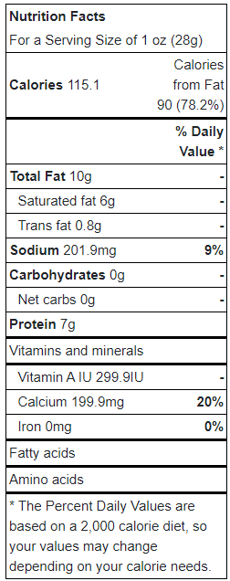
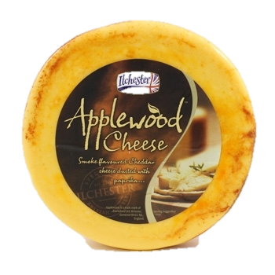
Semi-firm cheese
Semi-firm cheese
Semi-firm cheese
Milk: cow, pasteurized
Color: yellow
Type: thin rind
Aroma: smoky
Texture: crumbly, melting
Taste/flavour: woody, smoky
1
Applewood Smoked Cheddar
Cheese dairy:
Ilchester
Source: https://ultrafoods.ca/product/applewood-smoked-cheddar-cheese/

Slide 18
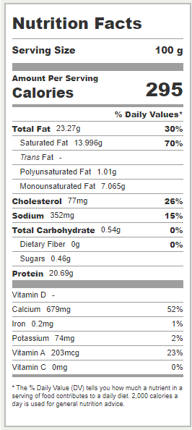
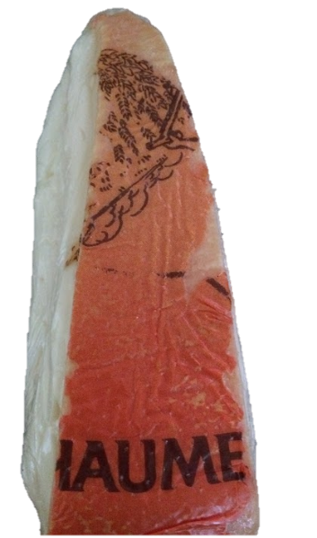
Soft cheese
Soft cheese
Milk: cow, pasteurized
Color: cream
Type: Soft cheese with washed rind
Aroma: strong, rancid
Texture: supple, creamy
Taste/flavour: chocolate
Soft cheese
1
Chaume original
Cheese dairy:
Chaume
Source: https://www.quiveutdufromage.com/f-chaumes
https://www.fatsecret.com/calories-nutrition/generic/french-chaumes-cheese
Notes:
Chaumes® cheese is produced in the heart of the “Purple Périgord”, in Saint-Antoine-de-Breuilh, about thirty kilometres west of Bergerac.
Chaumes®’s coppery rind conceals an ample aroma and a soft, supple texture. Its fabrication makes for its uniqueness, namely the brushing and washing of its rind.

