Slide 1
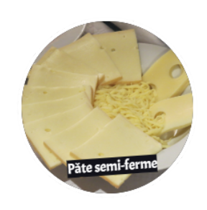
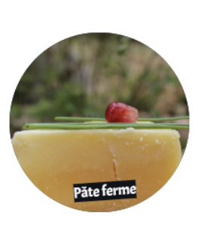
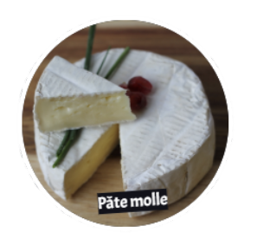
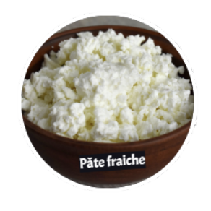
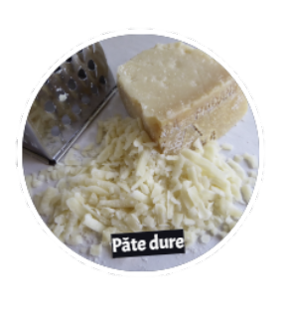
Tasting
Semi-firm cheese
Soft cheese
Firm cheese
The organoleptic properties of food are the properties perceived by the senses that allow us to recognize and appreciate them.
Fresh cheese
Hard cheese
Notes:
The images are taken from the animation
https://www.100kmfoods.com/blog/ontario-cheese-producers/
Canadian cheese awards - https://www.cheeseawards.ca/finalistsfinalistes2018/
https://www.cheeseawards.ca/accueil/

Slide 2
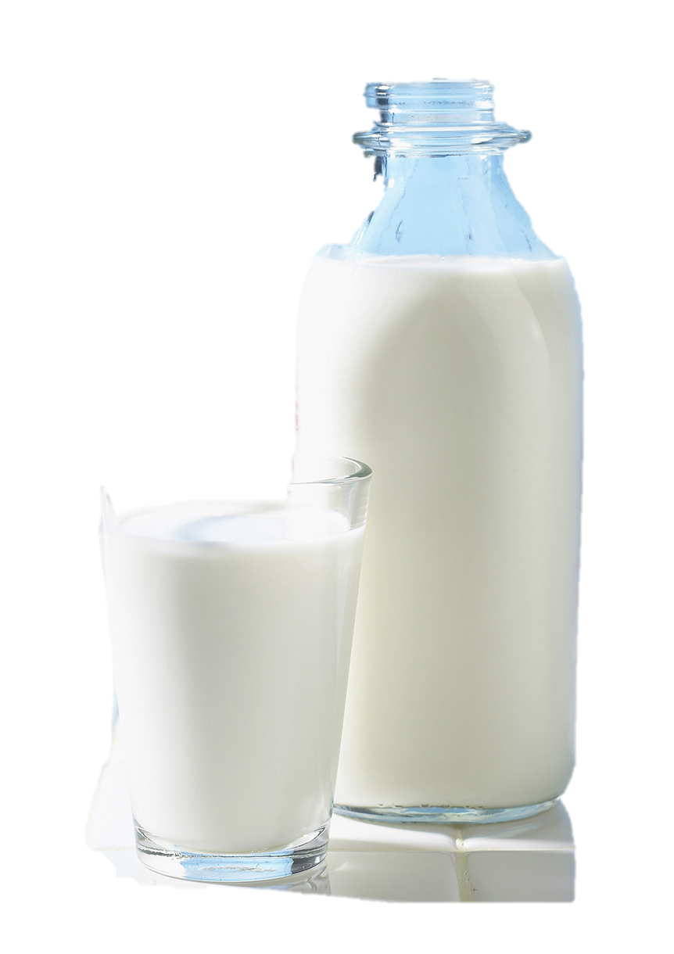
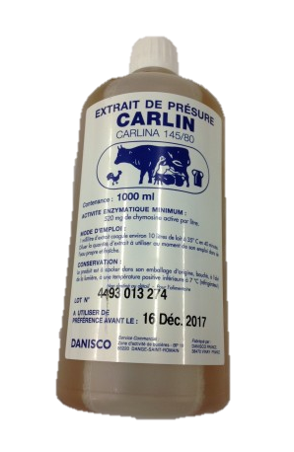
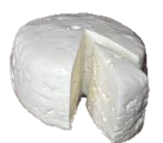
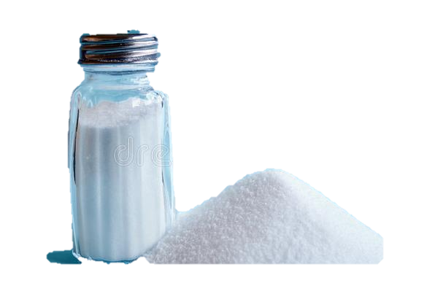
What is cheese?
+
=
+
Rennet/ enzyme
Milk
Salt
What distinguishes one cheese from another is the ripening, that is the maturation period, and the type of cheese.

Slide 3
Cheese families according to firmness
Semi-firm cheese
Soft cheese
Firm cheese
Fresh cheese
Hard cheese
Notes:
Images taken from animation
There are several methods of classifying cheeses based on various criteria: the type of milk (cow, goat, sheep, buffalo), the amount of fat (whole, skimmed, partially skimmed, enriched), the method of coagulation (lactic, rennet, mixed), the method of ripening and the visual appearance (no rind, dry rind, bloomy rind, washed rind, morghed rind).
In Canada, the classification is mainly based on the firmness of the cheese (fresh, soft, semi-soft, firm, hard).

Slide 4
Fresh cheeses
Fresh cheese
Fresh cheeses contain more than 80% moisture.
They have not undergone any ripening and their conservation is limited.
Their texture varies from liquid to creamy. Their taste is light and subtle.
They are always pure white.
Ricotta, Boursin, cottage cheese, cream cheese, white cheese, mascarpone, quark, etc.

Slide 5
Soft cheeses
Soft cheese
Soft cheeses have a moisture content between 50 and 60%.
They are soft, creamy, smooth and even runny.
The outer surface (crust) is seeded.
The ripening period is only a few weeks.
There are 2 types:
2) Washed rind
More compact
The surface is seeded with fungi and then washed and brushed with a salt solution.
1) Bloomy crust
The surface is seeded with fungi.
Bocconcini, Mozzarina, Feta
Camembert, Brie, triple cream
Notes:
Add images of each cheese

Slide 6
Semi-firm cheeses
Smi-firm cheese
Semi-firm cheeses have a moisture content between 45 and 50%.
They are compact and flexible.
There are 2 types.
They usually don’t have a rind. There are 3 main groups.
1) Unripened
No maturation
2) Mass ripened
They usually don’t have a rind and are ripened from the center of the cheese for a few months.
3) Surface ripened
They are washed with salty solutions and turned several times. Their ripening lasts a few months.
Haloumi, mozzarella
cheese curds
Monterey Jack, Havarti, Provolone, Gouda
Oka
Notes:
Maturation: 2-4 months

Slide 7
Firm cheeses
Firm cheese
Firm cheeses contain between 35 and 45% moisture.
Their texture is soft and stretchy.
They generally do not have a rind.
They are drained, pressed and cooked or semi-cooked.
Their ripening lasts from a few months to a few years.
They keep for a very long time.
Cheddar, Provolone, Swiss, Raclette, Jalsberg

Slide 8
Hard cheeses
Hard cheese
Hard cheeses contain less than 35% moisture.
It is a very hard cheese.
Its ripening, as well as its conservation, lasts several years.
Parmesan, Gruyere, Emmental, Pecorino, etc.

